Slide 1
Mendelian Genetics in Populations II: Migration, Genetic Drift, and Nonrandom Mating
Motivation
What happens when we depart from HW assumptions?
Pattern of genetic diversity, fitness consequences.

Slide 2
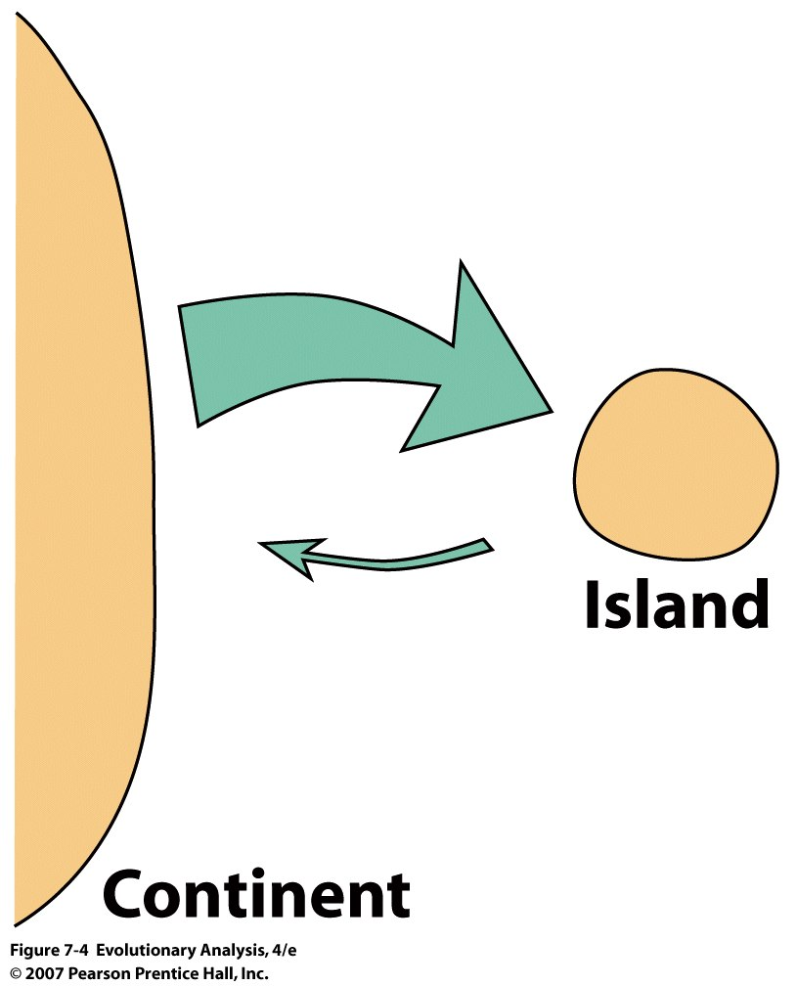
II. Migration
Also among islands, or between
populations on the mainland, etc.
Notes:
Figure 7.4 The one-island model of migration
The arrows in the diagram show the relative amount of gene flow between the island and continental populations. Alleles arriving on the island from the continent represent a relatively large fraction of the island gene pool, whereas alleles arriving on the continent from the island represent a relatively small fraction of the continental gene pool.

Slide 3
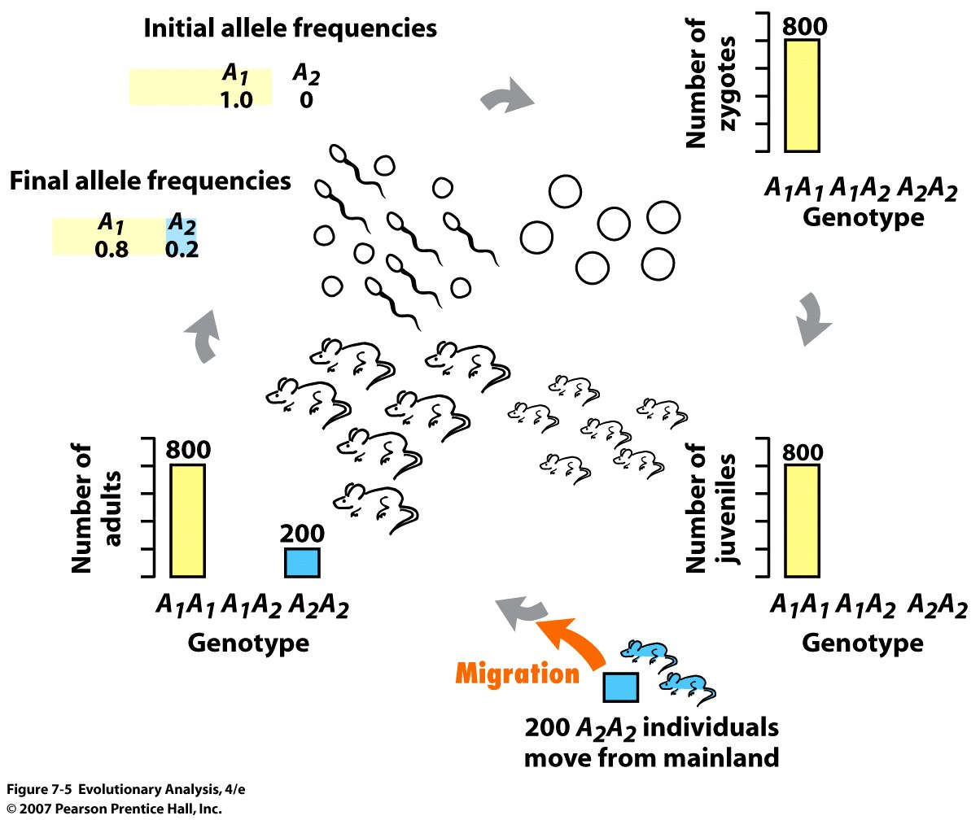
Notes:
Figure 7.5 Migration can alter allele and genotype frequencies
This diagram follows an imaginary island population of mice from one generation's gene pool (initial allele frequencies) to the next generation's gene pool (final allele frequencies).The bar graphs show the number of individuals of each genotype in the population at any given time. Migration, in the form of individuals arriving from a continental population fixed for allele A₂, increases the frequency of allele A₂ in the island population.

Slide 4
Effect of migration on allele frequencies:
m, 1-m,
p and p_{m}
p’ = p after migration
p’ = p(1-m) + p_{m}(m)
Change in p = p’ – p = p(1-m) + pm(m) – p =
= p – pm + p_{m}(m) – p
= m(p_{m} – p)
Effect is to homogenize!
Notes:
Equilibrium is when pm = p or m is 0
when is the change = 0??

Slide 5
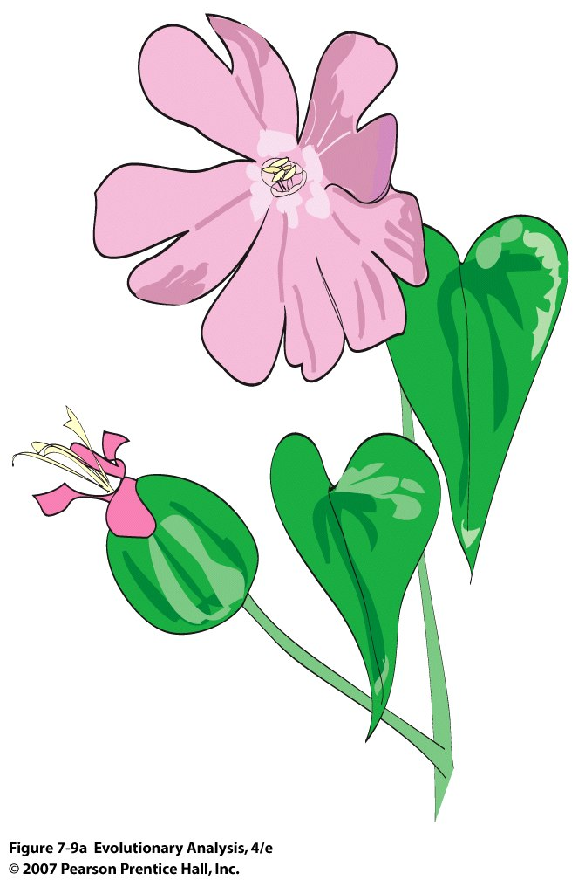
Variation in allele frequencies among populations of
red bladder campion Silene dioica
Notes:
Figure 7.9a Variation in allele frequencies among populations of red bladder campion Silene dioica
(a) Red bladder campion, a perennial wildflower.

Slide 6
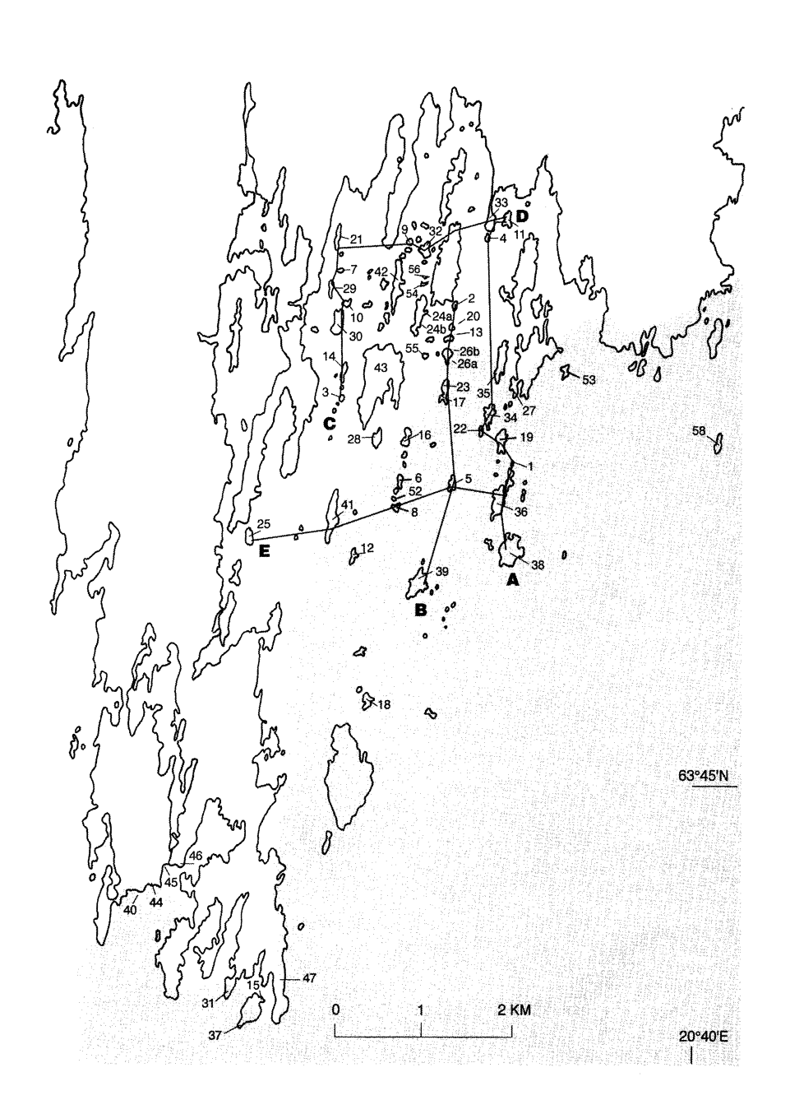
Silene dioica on Skeppsvik Archipelago, Sweden

Slide 7
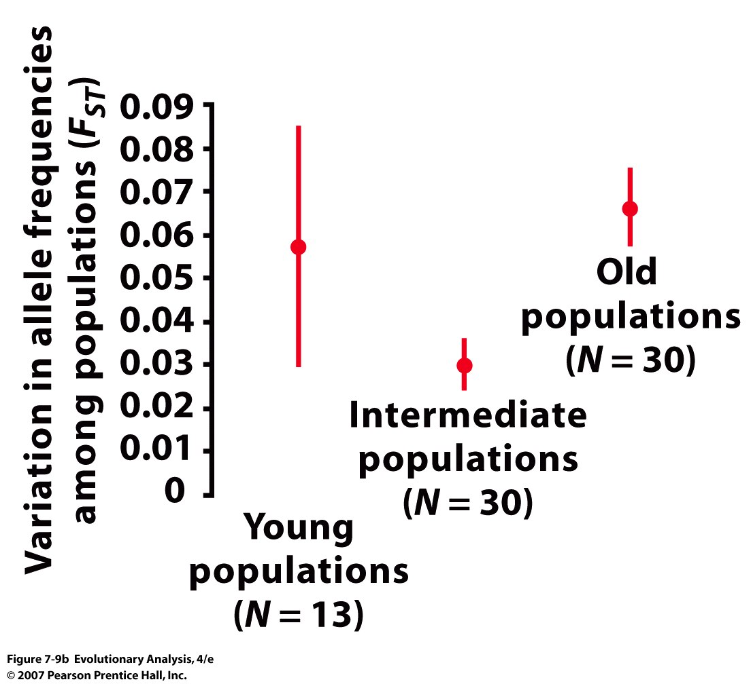
Fst = (He – Ho)/ He
Notes:
Closer p and q in population are to global population, less Fst
Figure 7.9b Variation in allele frequencies among populations of red bladder campion Silene dioica
(b) Giles and Goudet's (1997) measurements of variation in allele frequencies among populations. The red dots represent values of F_{ST} (see text); the vertical red lines represent standard errors (larger standard errors represent less certain estimates of F_{ST}). There is less variation in allele frequencies among intermediate age populations than among young populations (P = 0.05). There is more variation in allele frequencies among old populations than among intermediate populations (P = 0.04). After Giles and Goudet (1997).

Slide 8
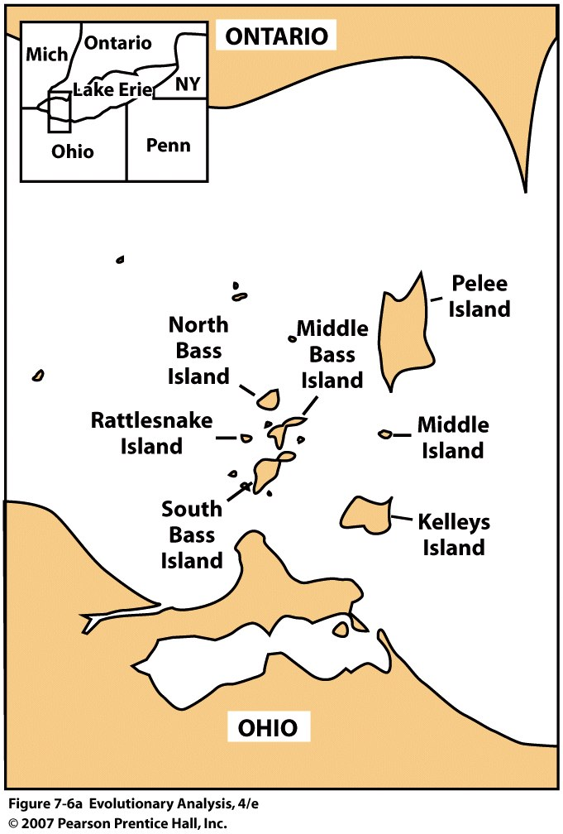
Migration and
selection in
banded water
snakes
Notes:
Figure 7.6a Water snakes and where they live
The map in (a) shows the island and mainland areas in and around Lake Erie where Richard King and colleagues studied migration as a mechanism of evolution in water snakes. From King and Lawson (1995).
KING RB Source: CANADIAN JOURNAL OF ZOOLOGY-REVUE CANADIENNE DE ZOOLOGIE Volume: 71 Issue: 10 Pages: 1985-1990 Published: OCT 1993 Times Cited: 13 References: 37 Citation Map Abstract: The hypothesis that color pattern variation in Lake Erie island water snake (Nerodia sipedon) populations results from the opposing effects of natural selection and gene flow requires that this variation have a genetic basis. To determine whether color pattern variation is genetically based, data on the color pattern of wild-caught females and their captive-born offspring were used to estimate heritability of and correlations among four color pattern components. These data, and the results of two laboratory crosses, were also used to test for major locus influences on color pattern. Heritabilities of color pattern components estimated from sib analysis were significantly greater than zero for all four color pattern components, ranging from 0.34 to 0.79. Phenotypic and genetic correlations among color pattern components were positive, ranging from 0.24 to 0.55 (phenotypic correlations) and from 0.40 to 0.82 (genetic correlations). However, inheritance of color pattern was not strictly quantitative. Rather, a major locus appeared to influence color pattern, with alleles at this locus possibly determining whether snakes had regular (mainland-like) or reduced color patterns. Allele frequencies at this locus may have influenced the rate at which island and mainland water snake populations initially differentiated from each other, and may explain the lack of reduced-pattern morphs under similar selective regimes elsewhere.

Slide 9
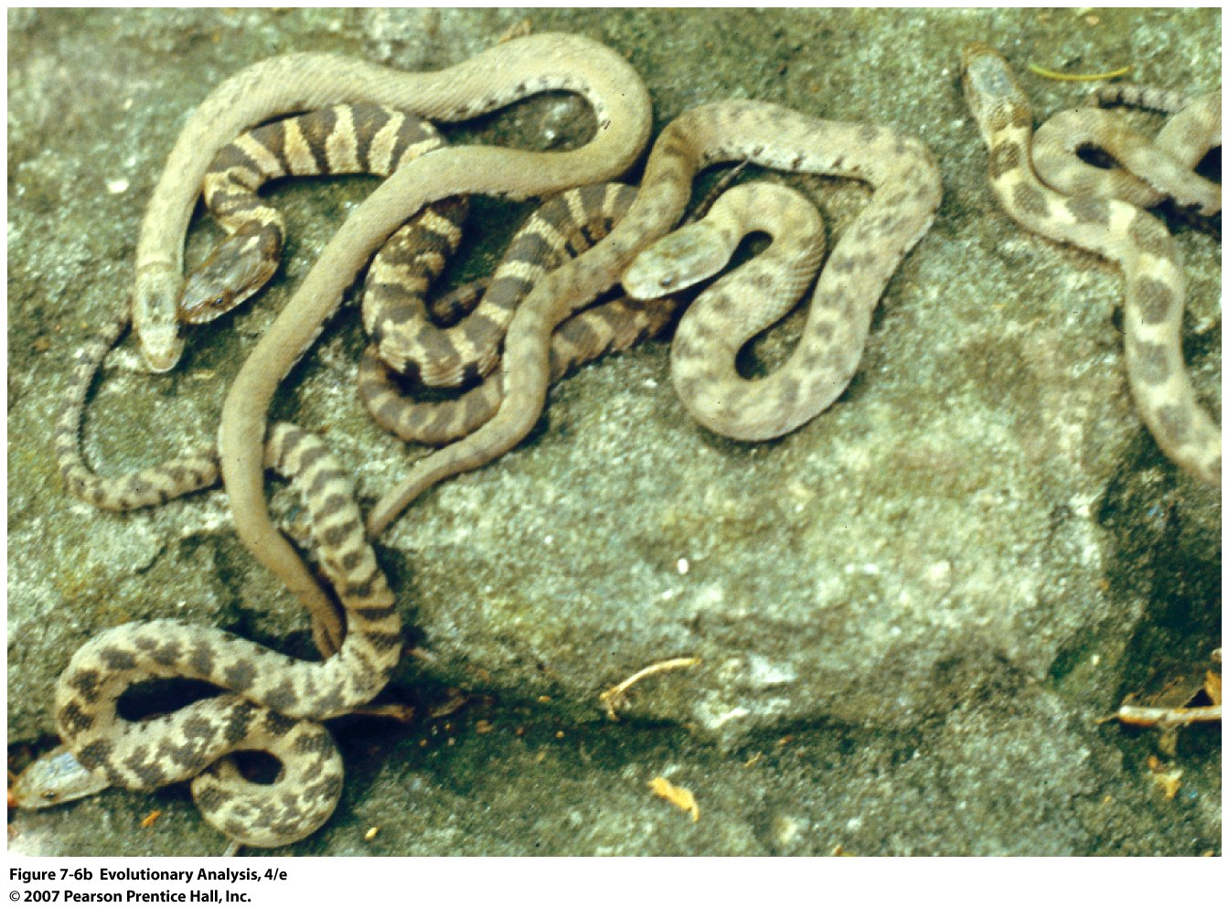
Banded (A1A1, A1A2 ) is dominant to unbanded (A2A2)
Notes:
Figure 7.6b Water snakes and where they live (islands = mostly limestonerocks)
The photo in (b) shows unbanded, banded, and intermediate forms of the Lake Erie water snake (Nerodia sipedon). From King and Lawson (1995).

Slide 10
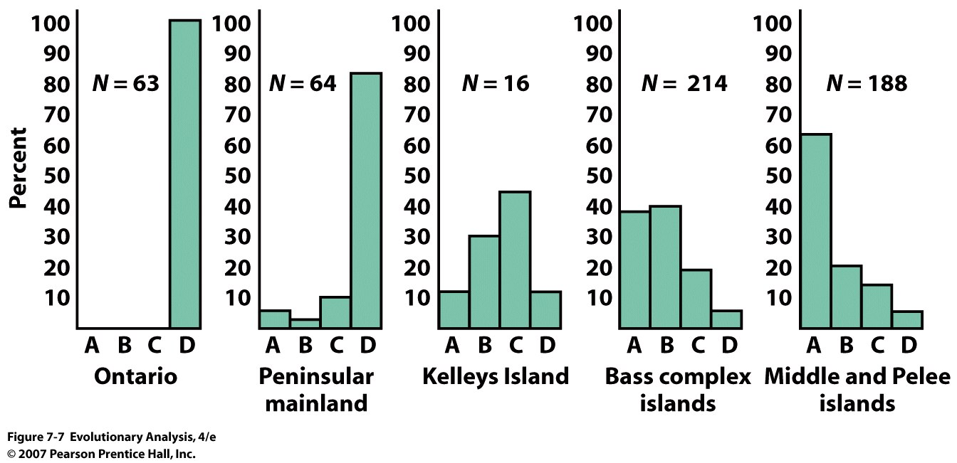
Variation in color pattern within and between populations
A = Unbanded, D = Banded, B and C = Intermediate
Notes:
Figure 7.7 Variation in color pattern within and between populations
These histograms show frequency of different color patterns in various populations. Category A snakes are unbanded; category B and C snakes are intermediate; category D snakes are strongly banded. Snakes on the mainland tend to be banded; snakes on the islands tend to be unbanded or intermediate. From Camin and Ehrlich (1958).

Slide 11
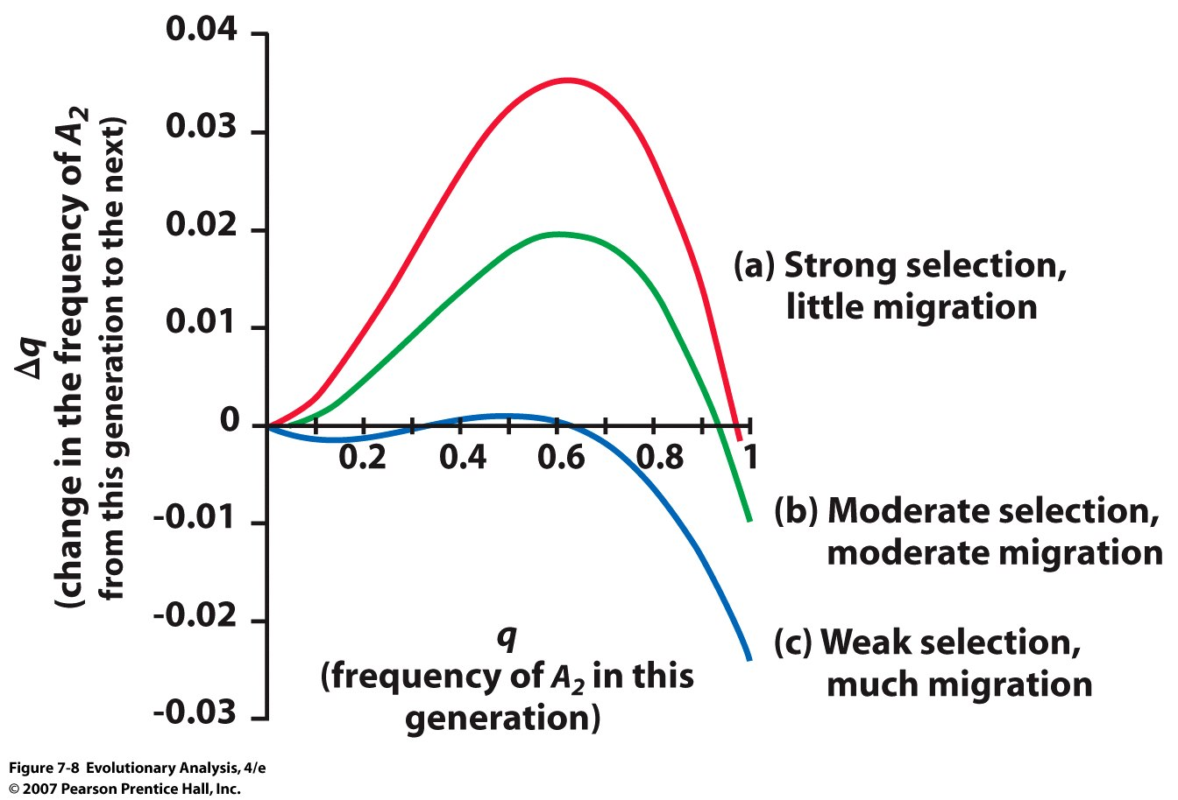
The combined effects of selection and migration on allele
frequencies in island water snakes
~ equilibrium
Notes:
Where the curves cross “0” is where there is equilibrium
Figure 7.8 The combined effects of selection and migration on allele frequencies in island water snakes
The curves show Δq as a function of q for different combinations of migration and selection. See text for details.

Slide 12
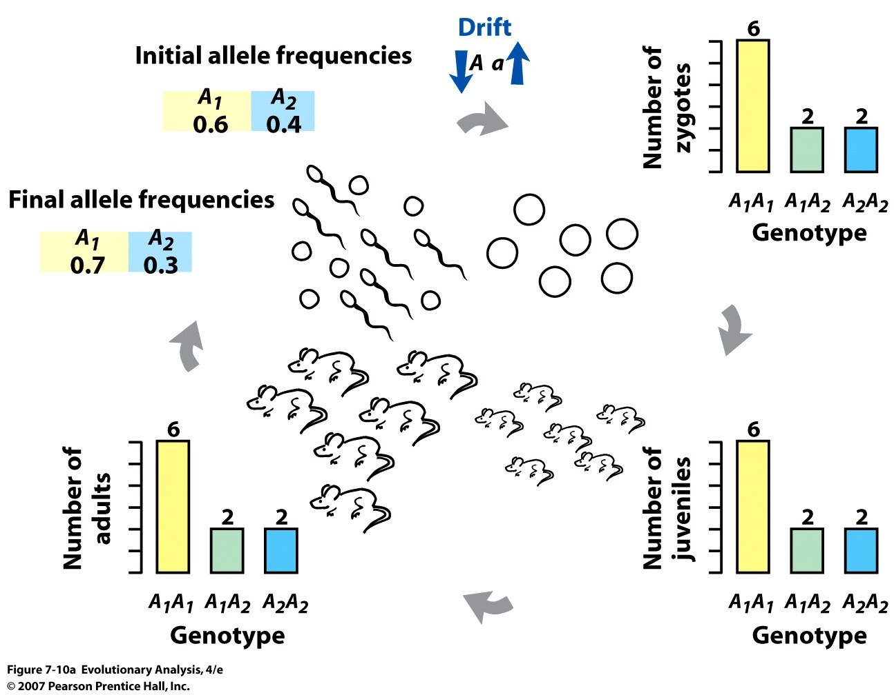
III. Drift and Consequences for Genetic Diversity
Notes:
Figure 7.10a Chance events can alter allele and genotype frequencies
(a) This diagram follows an imaginary population of 10 mice from one generation's gene pool (initial allele frequencies) to the next generation's gene pool (final allele frequencies). The bar graphs show the number of individuals of each genotype in the population at any given time. Genetic drift, in the form of sampling error in drawing gametes from the initial gene pool (b) to make zygotes, increases the frequency of allele A₁. Note that many other outcomes are also possible.

Slide 13
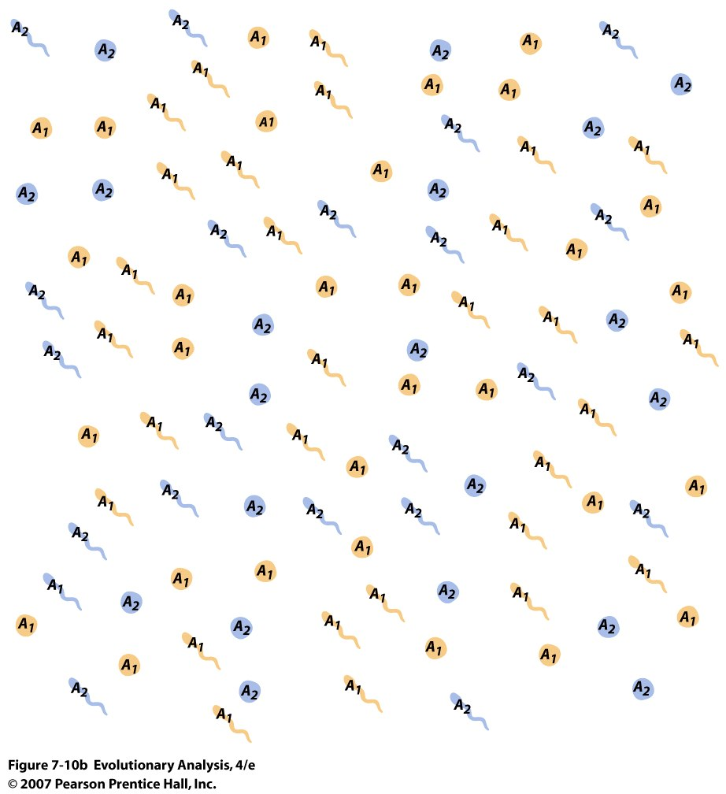
Coin Toss
Notes:
Figure 7.10b Chance events can alter allele and genotype frequencies
(a) This diagram follows an imaginary population of 10 mice from one generation's gene pool (initial allele frequencies) to the next generation's gene pool (final allele frequencies). The bar graphs show the number of individuals of each genotype in the population at any given time. Genetic drift, in the form of sampling error in drawing gametes from the initial gene pool (b) to make zygotes, increases the frequency of allele A₁. Note that many other outcomes are also possible.

Slide 14
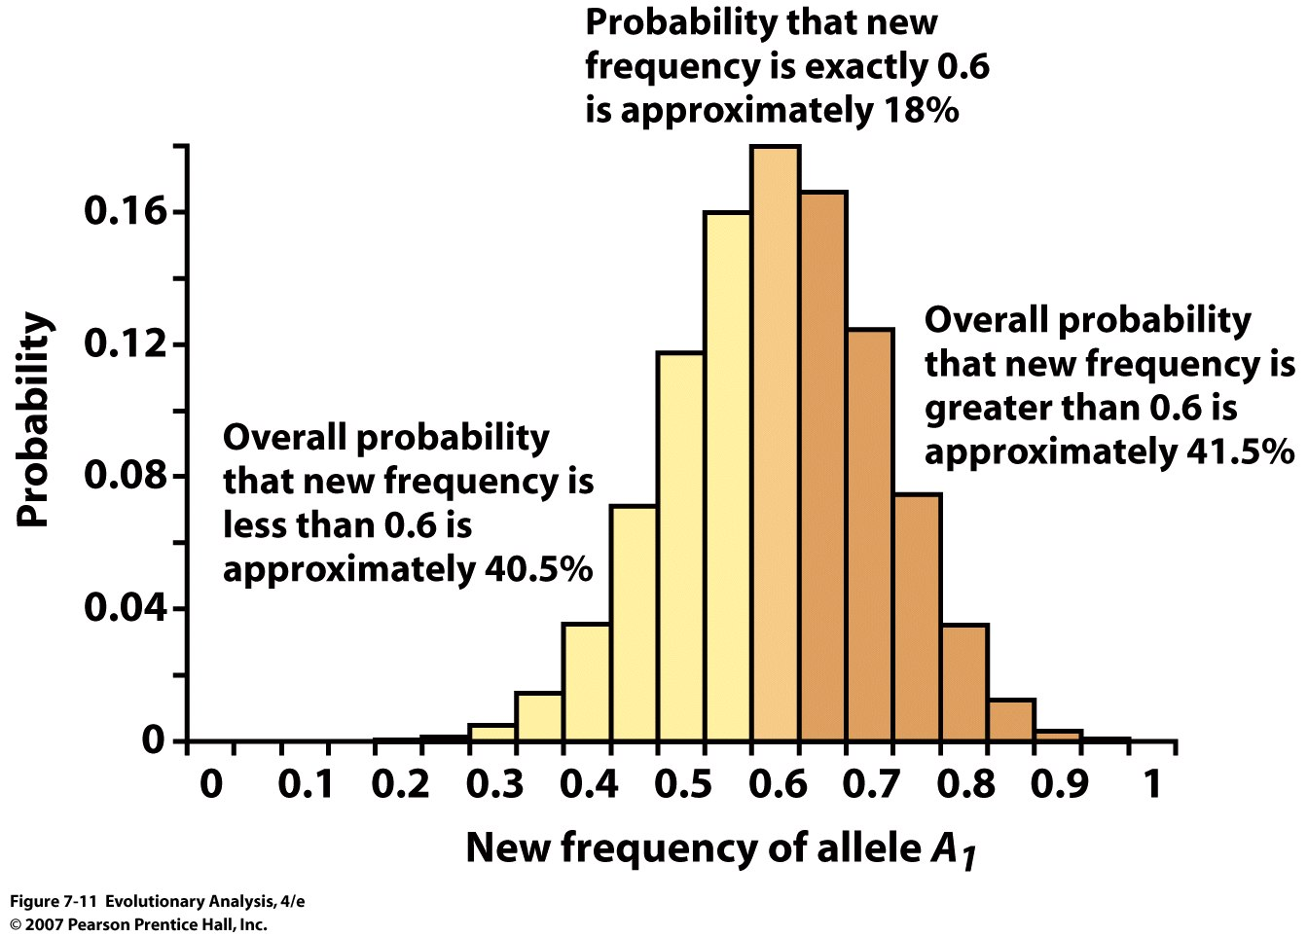
Notes:
Figure 7.11 The range of possible outcomes in our model population of ten mice
This graph shows the possible outcomes, and the probability of each, when we make 10 zygotes by drawing alleles from a gene pool in which alleles A₁ and A₂ have frequencies of 0.6 and 0.4. The single most probable outcome is that the allele frequencies will remain unchanged. However, the chance of this happening is only about 18%.

Slide 15
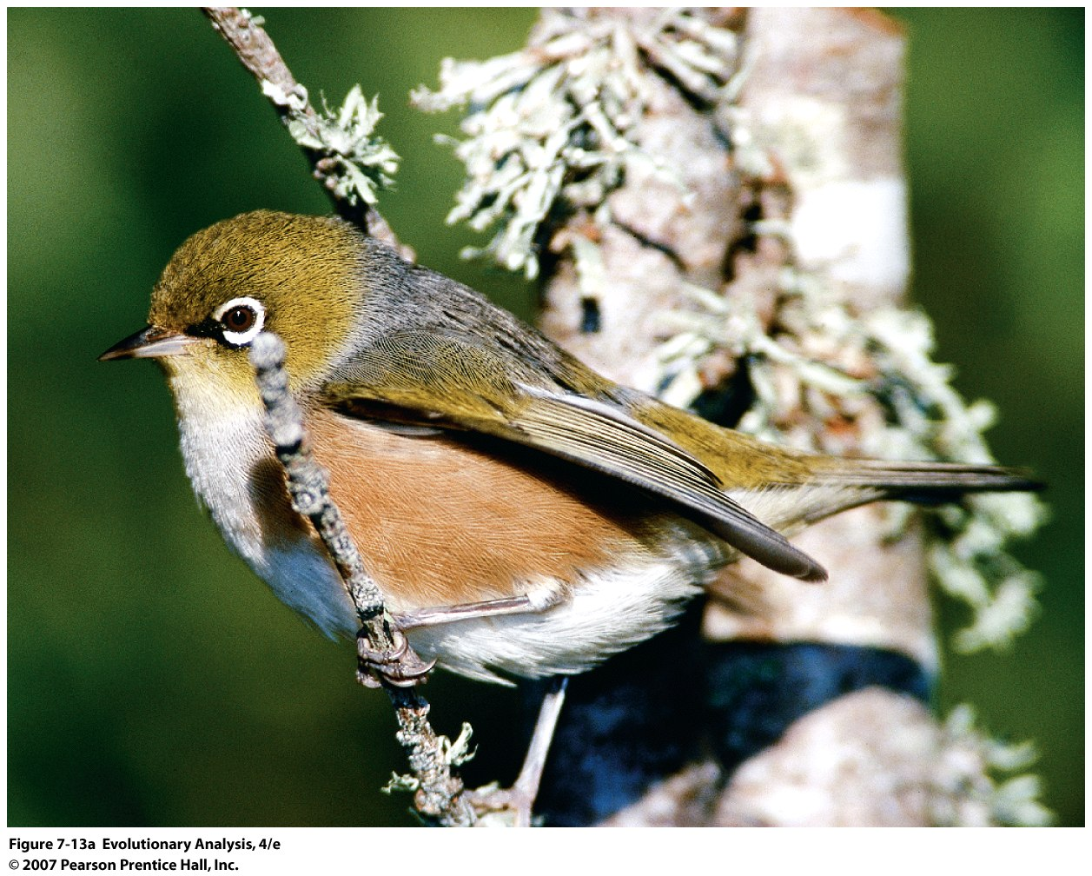
The founder effect in an island-hopping bird
silvereye, Zosterops lateralis.
Notes:
Figure 7.13a The founder effect in an island-hopping bird
(a) A silvereye, Zosterops lateralis.

Slide 16
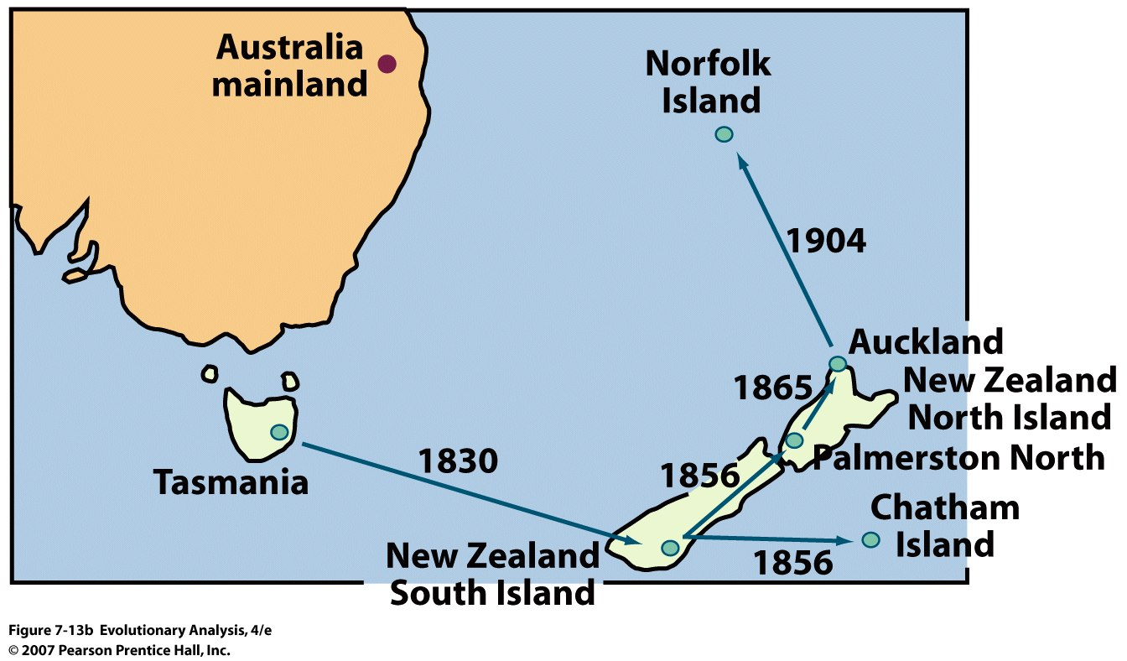
Silvereyes have been documented to colonize new islands
in recent history.
Notes:
Figure 7.13b The founder effect in an island-hopping bird
(b) Silvereyes have been documented to colonize new islands in recent history.

Slide 17
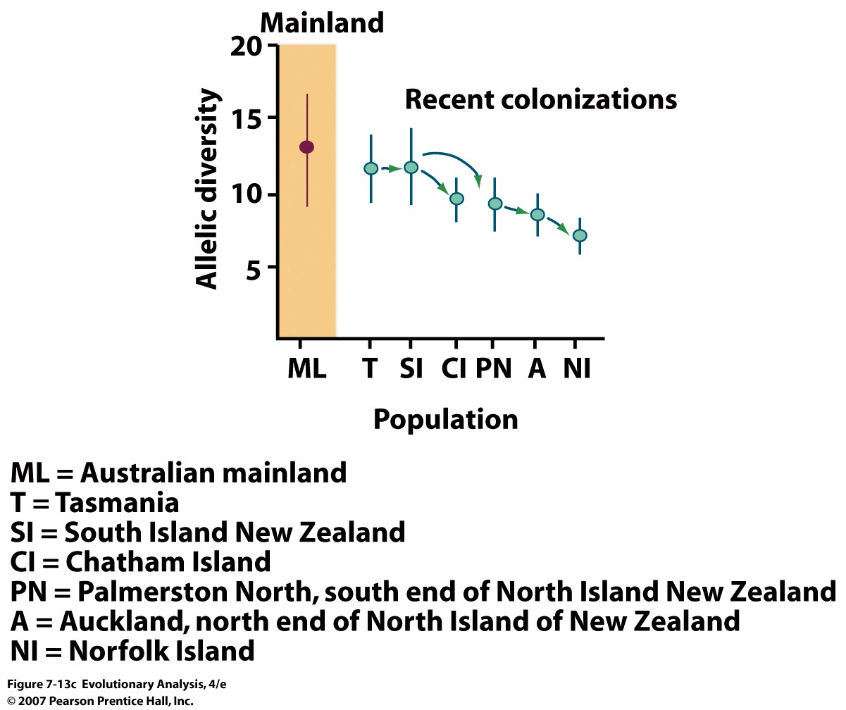
Allelic diversity has declined along the silvereye's route of travel
Notes:
Figure 7.13c The founder effect in an island-hopping bird
(c) Allelic diversity has declined along the silvereye's route of travel. From Clegg et al. (2002).

Slide 18
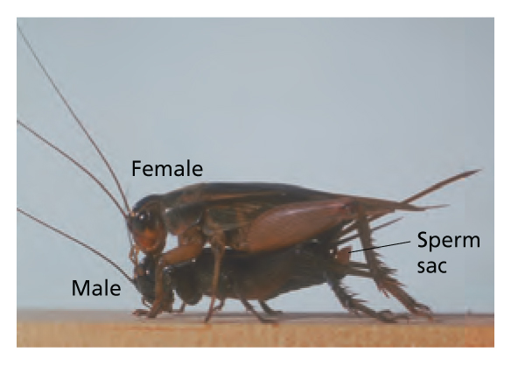
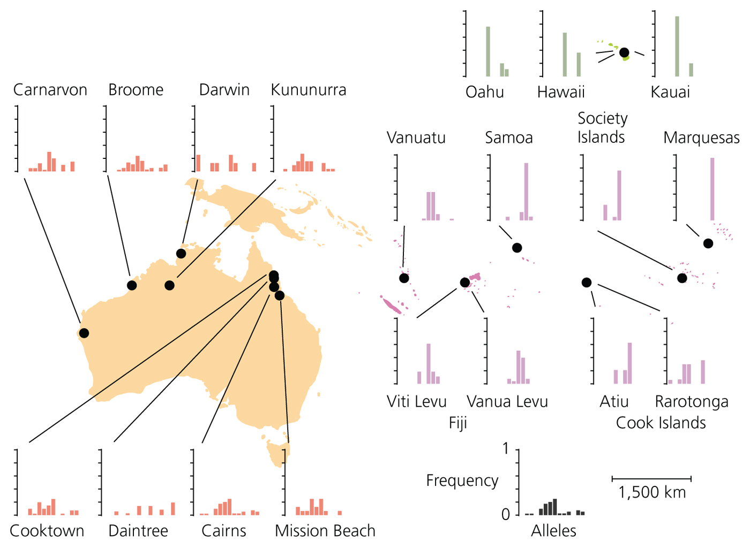
Allelic diversity in the Pacific Field Cricket

Slide 19
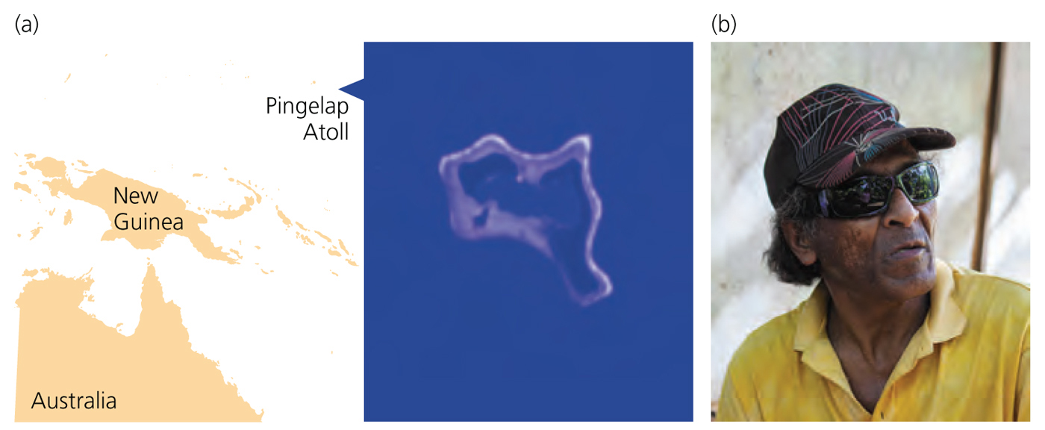
High frequency of disease alleles in small populations: Pingelapese, Quebecois, Ashkenazy, Lancaster Dutch, etc.

Slide 20
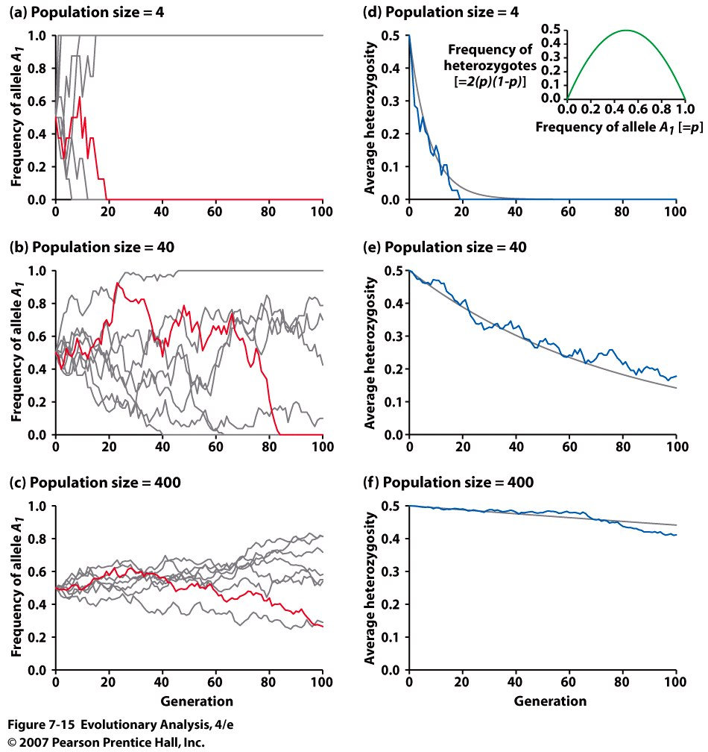
Simulations of genetic drift in populations of different sizes
Notes:
Figure 7.15 Simulations of genetic drift in populations of different sizes
Plots (a), (b), and (c) show the frequency of allele A₁ over 100 generations. Eight populations are tracked in each plot, with one population highlighted in red. Plots (d), (e), and (f) show the average frequency of heterozygotes over 100 generations in the same sets of simulated populations. The gray curves represent the rate of decline predicted by theory.The inset in plot (d) shows the frequency of heterozygotes in a population, calculated as 2(p)(1 - p), as a function of p, the frequency of allele A₁. Collectively, the graphs in this figure show that genetic drift leads to random fixation of alleles and loss of heterozygosity and that drift is a more potent mechanism of evolution in small populations.

Slide 21
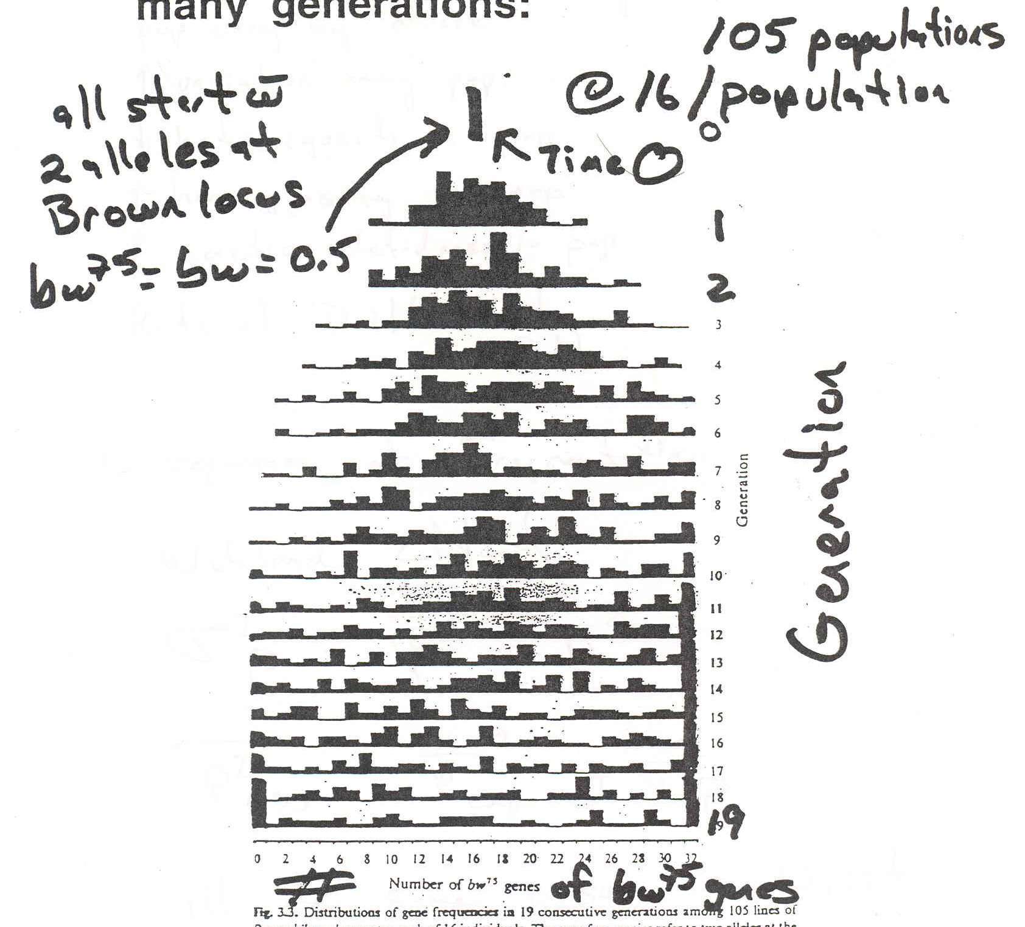
Effect of sampling variation after many generations
Change in allele frequencey of Drosophila melanogaster populations
Notes:
Variance of a binomal (for number of successes, or number of heads, or for sampling alleles) = npq
Variance of a binomial (for proportion of successes) = (pq)/n
refer back to Giles work

Slide 22
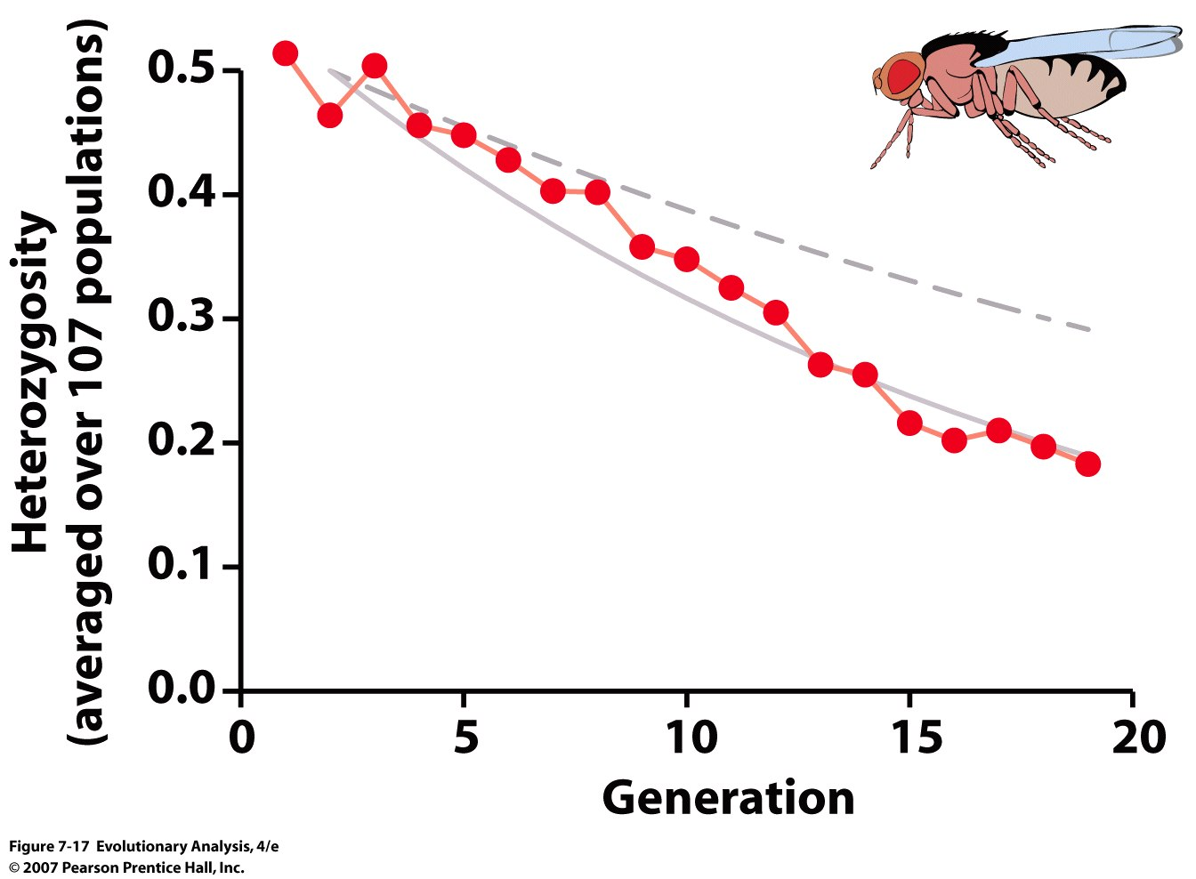
Notes:
Figure 7.17 The frequency of heterozygotes declined with time in Buri's experimental populations
The red dots show the frequency of heterozygotes in each generation, averaged across all 107 populations. The dashed gray curve shows the theoretical prediction for a population of 16 flies. The solid gray curve shows the theoretical prediction for a population of 9 flies. The graph demonstrates that (1) heterozygosity decreases across generations in small populations, and (2) although all the populations had an actual size of 16 flies, their effective size was roughly 9. Replotted from data in Buri (1956), after Hartl (1981).

Slide 23
Effective population size:
The size of the population that would give rise to the observed loss of
heterozygosity each generation, or increase of variation between
populations each generation.
Variation in sex ratios:
Ne = (4NmNf)/(Nm + Nf) (Genghis Kahn example)
Imagine 10,000 males and 10,000 females all reproducing
then Ne = 20,000
Vs
1 male and 10,000 females = (40,000)/10,001 = 4
Notes:
8% if all males in central Asia have Y chromosome of GK
Typically the effective population size is about 10-20% of the census population size

Slide 24
Ne = harmonic mean number of individuals across generations:
H = N/(1/x1 + 1/x2, + …1/xn)
Imagine the following population dynamics:
A population is founded by 10 individuals and then grows by 10X
each generation for 10 generations:
10, 100, 1000, ….10¹⁰
Ne = 10 (generations)/(1/10 +1/100 +1/1000...1/100,000,000,000)
Ne = 10/0.1111111111
Ne ~ 90 individuals!!!!
Once a population is inbred, the inbreeding is NEVER LOST
Notes:
H = N/(1/x1 + 1/x2, + …1/xn)

Slide 25
Heterozygosity decreases by 1/2Ne per generation
Example:
Imagine a population of 3 zygotes:
A1A2 A3A4 A5A6 producing
A1, A2, A3, A4, A5, and A6 gametes
The chance is 1/6 that any of the next generation zygotes will be homozygous

Slide 26
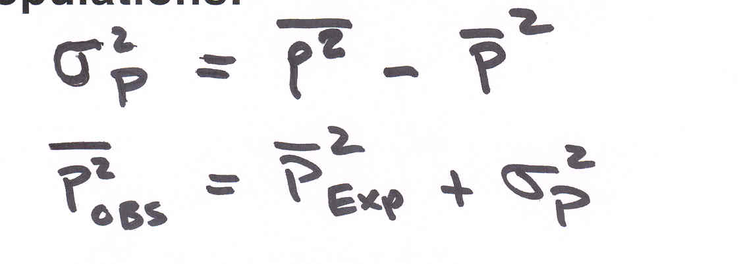
Consequences of Fragmentation
Wahlund Effect:
All of the same consequences as Drift
decreases heterozygosity within populations
increases homozygosity within populations
increases genetic relatedness within populations
Notes:
Show class why Ne is relatd to loss of heterozygosity, the A1A2 A3A4 A5A6 example
Variance can be written for a binomial distribution , obsrved homozygosity = expected + variance
Allude to genetic rescue

Slide 27
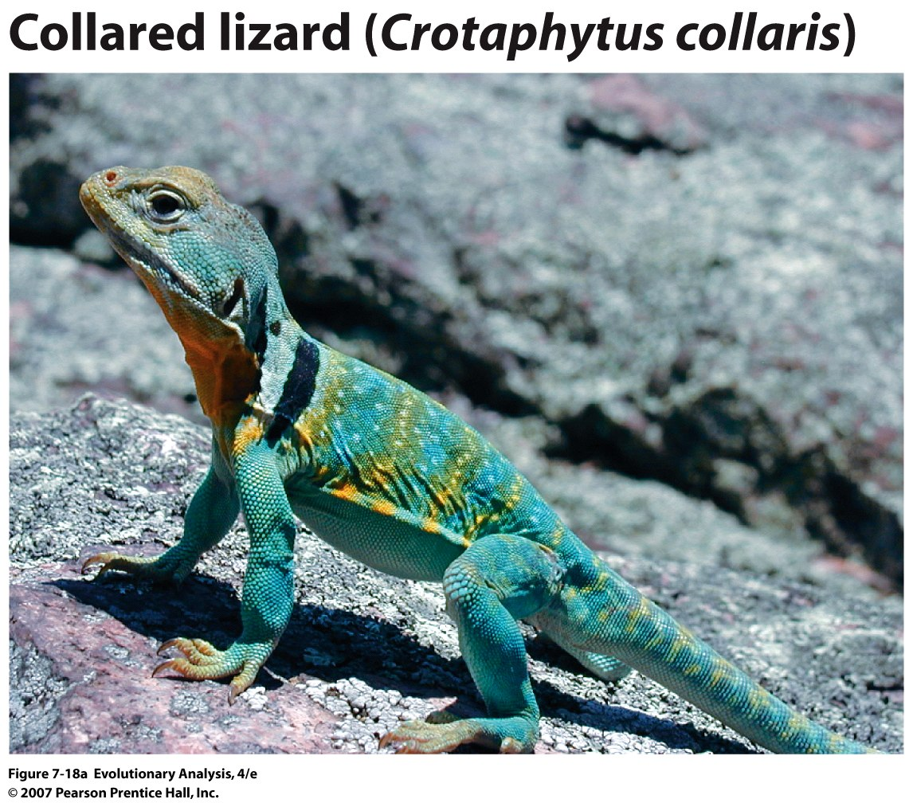
Notes:
Figure 7.18a Genetic variation in Ozark glade populations of the collared lizard
(a) A collared lizard.

Slide 28
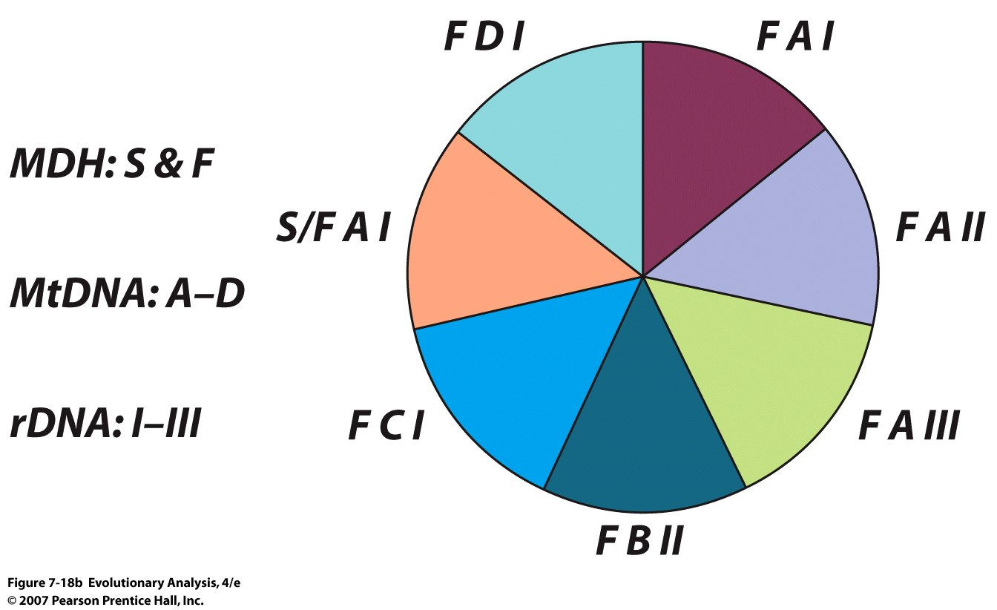
Random mating??
Notes:
Figure 7.18b Genetic variation in Ozark glade populations of the collared lizard
(b) This pie diagram gives a key to the seven distinct multilocus genotypes that Templeton et al. (1990) found in Ozark collared lizards. Each multilocus genotype is characterized by a malate dehydrogenase (MDH) genotype [the two alleles are "slow" (S) and "fast" (F)], a mitochondrial DNA haplotype (designated A-D), and a ribosomal DNA genotype (designated I-III). Versus 2 x 4 x 3 = 24 types expected, What genotype is MISSING!

Slide 29
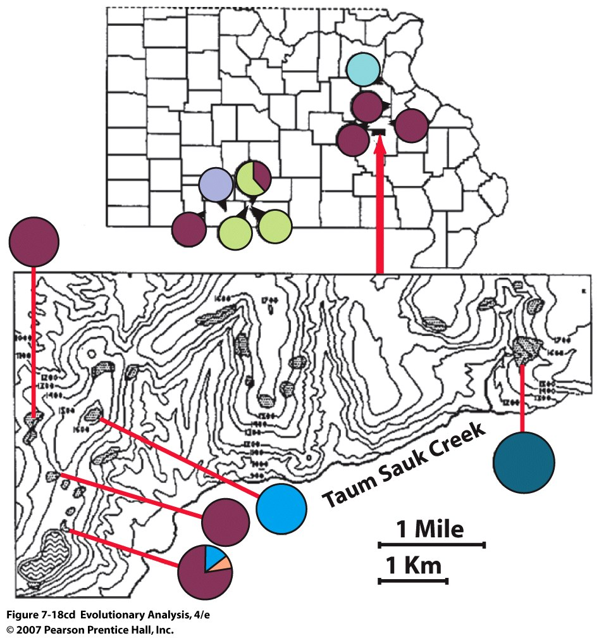
Notes:
Figure 7.18cd Genetic variation in Ozark glade populations of the collared lizard
(c) This is a map of southern Missouri, showing the locations and genetic compositions of nine glade populations. The shading of each pie diagram represents the frequency in a single population of each multilocus genotype present. (d) This is an expanded map of a small piece of the map in (c). It gives the locations and genetic compositions of five more glade populations. From Templeton et al. (1990).
Also seen in planrs

Slide 30
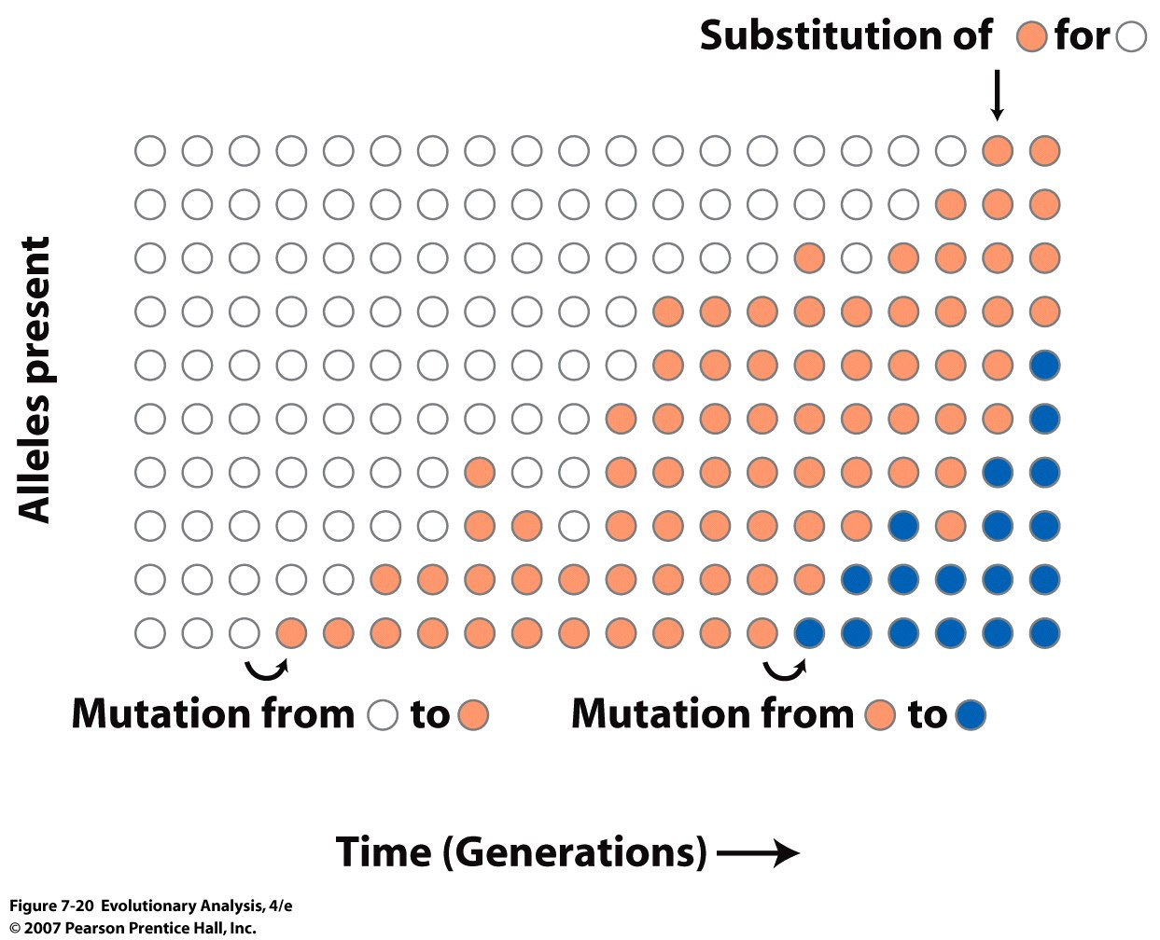
Drift and Rates of Evolutionary Change
Notes:
Now that we have discussed drift, can we use drift to explain patterns of genetic variation across species
Probability of fixation of a new mutation is 1/2n, or x over 2n
Rate of evolutionary substitution is equal to the mutation rate:
N, 2N alleles, v is rate of selectively neutral alleles, 2Nv mutations every generation, 1/2Nv fixed
U = uL(d +b + n) = u Ld + uLb + uln, v = uln
Figure 7.20 Mutation is the creation of a new allele; substitution is the fixation of the new allele, with or without additional mutational change
This graph shows the 10 alleles present in each of 20 successive generations, in a hypothetical population of five individuals. During the time covered in the graph, the light orange allele was substituted for the white allele. The blue allele may ultimately be substituted for the light orange allele, or it may be lost.

Slide 31
Notes:
Figure 7.21a Molecular evolution in influenza viruses is consistent with the neutral theory
Because the genetic code is redundant (a), there are two kinds of point mutations (b). The neutral theory predicts that both kinds of substitution will accumulate in populations by genetic drift, but that synonymous, or silent, substitutions will accumulate faster, as happens in flu viruses (c). From Gojoburi et al. (1990).

Slide 32
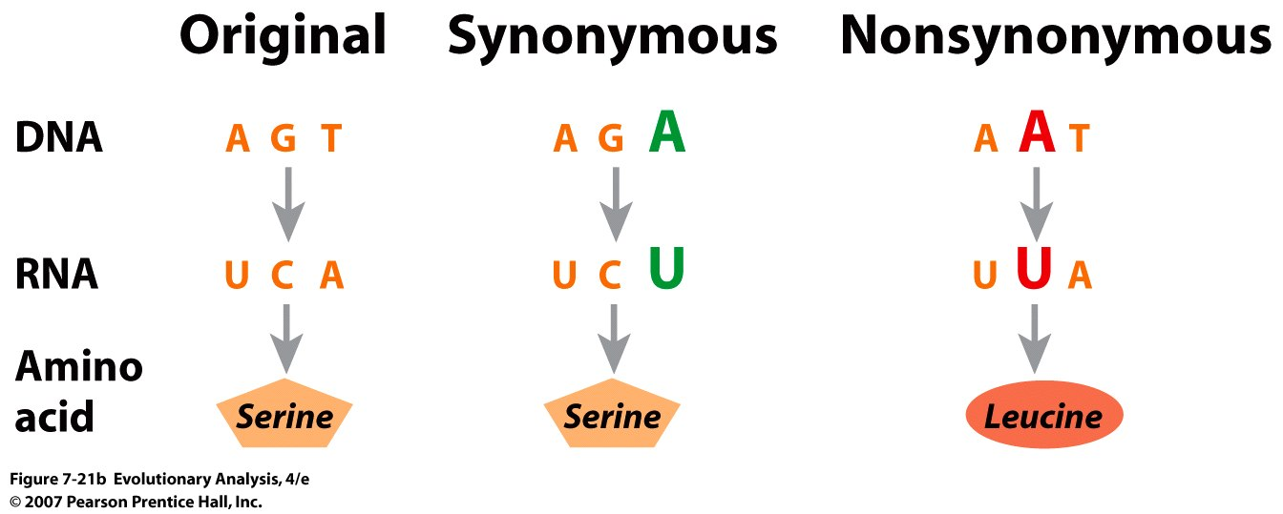
Notes:
Figure 7.21b Molecular evolution in influenza viruses is consistent with the neutral theory
Because the genetic code is redundant (a), there are two kinds of point mutations (b). The neutral theory predicts that both kinds of substitution will accumulate in populations by genetic drift, but that synonymous, or silent, substitutions will accumulate faster, as happens in flu viruses (c). From Gojoburi et al. (1990).

Slide 33
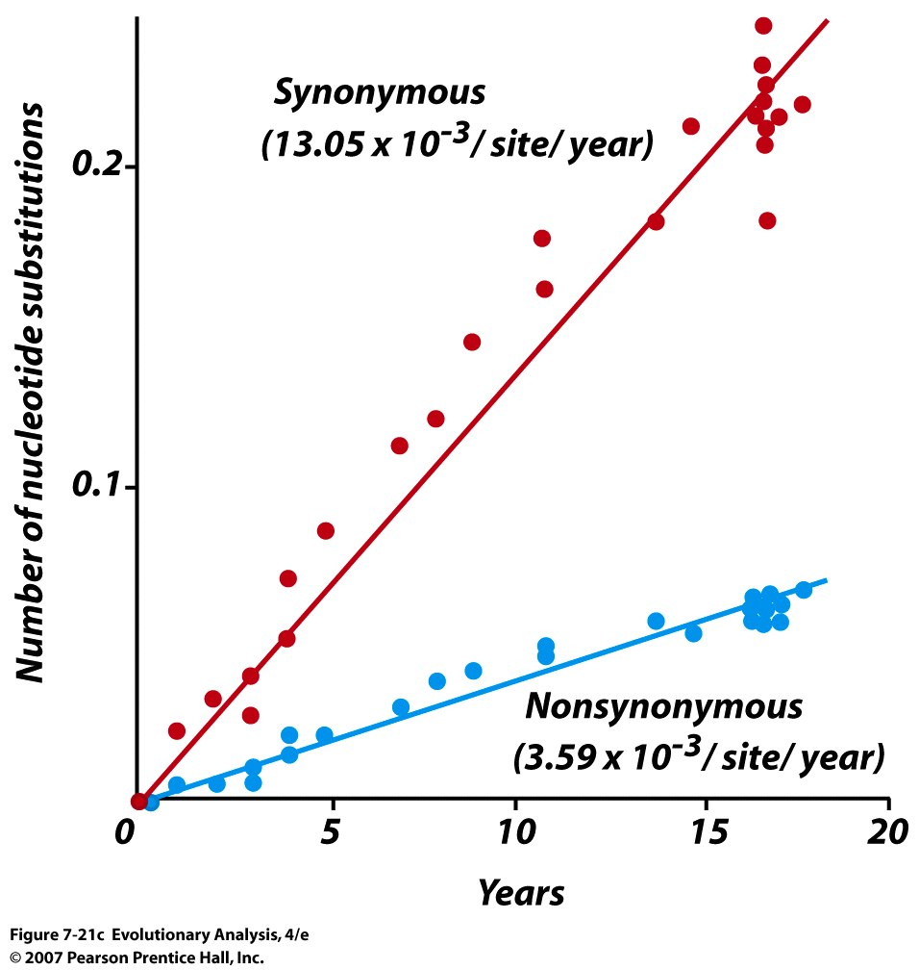
Clock like substitution rate
Drift??
Notes:
Figure 7.21c Molecular evolution in influenza viruses is consistent with the neutral theory
Because the genetic code is redundant (a), there are two kinds of point mutations (b). The neutral theory predicts that both kinds of substitution will accumulate in populations by genetic drift, but that synonymous, or silent, substitutions will accumulate faster, as happens in flu viruses (c). From Gojoburi et al. (1990).

Slide 34
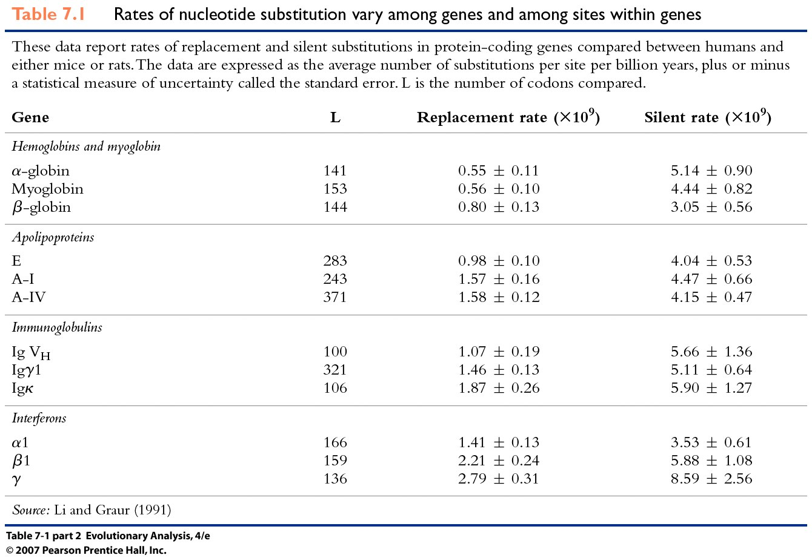
Notes:
Table 7.1 (part 2) Rates of nucleotide substitution vary among genes and among sites within genes

Slide 35
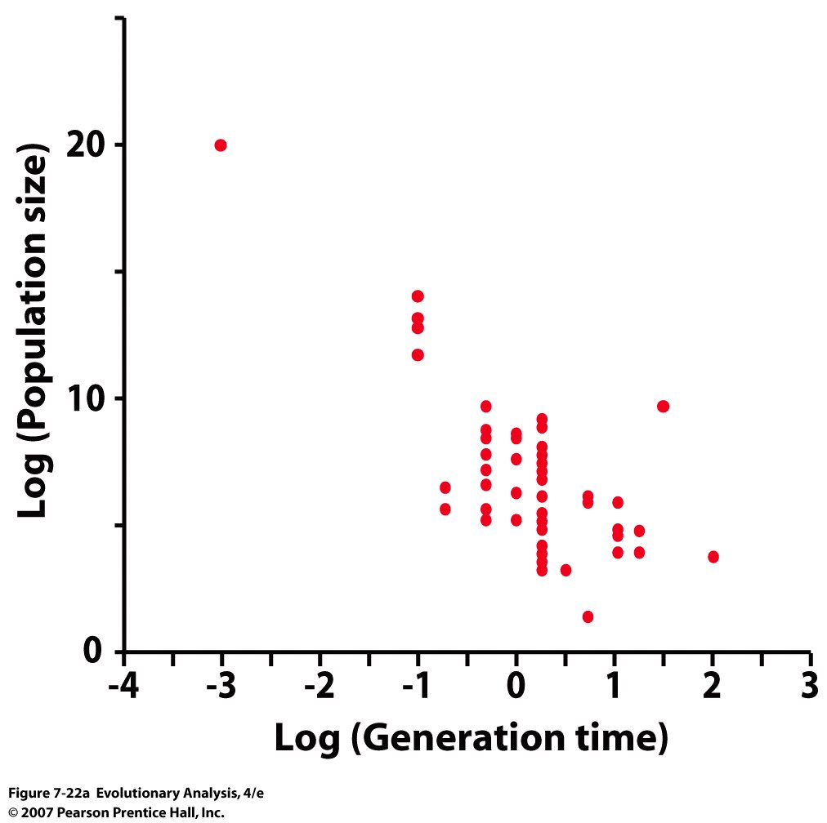
Why are substitution rates uniform across species
with different generation times??
Notes:
Figure 7.22a Generation time, population size, and nearly neutral mutations
(a) This graph plots the logarithm of population size versus the logarithm of generation time. Statistical tests confirm that there is a strong negative correlation between the two variables. From L. Chao and D. E. Carr (1993). Or mitosis, see Nei 2012

Slide 36
Notes:
Figure 7.22b Generation time, population size, and nearly neutral mutations
(b) Differences in generation time and population size can lead to clocklike change in replacement substitutions that are nearly neutral with respect to fitness.

Slide 37
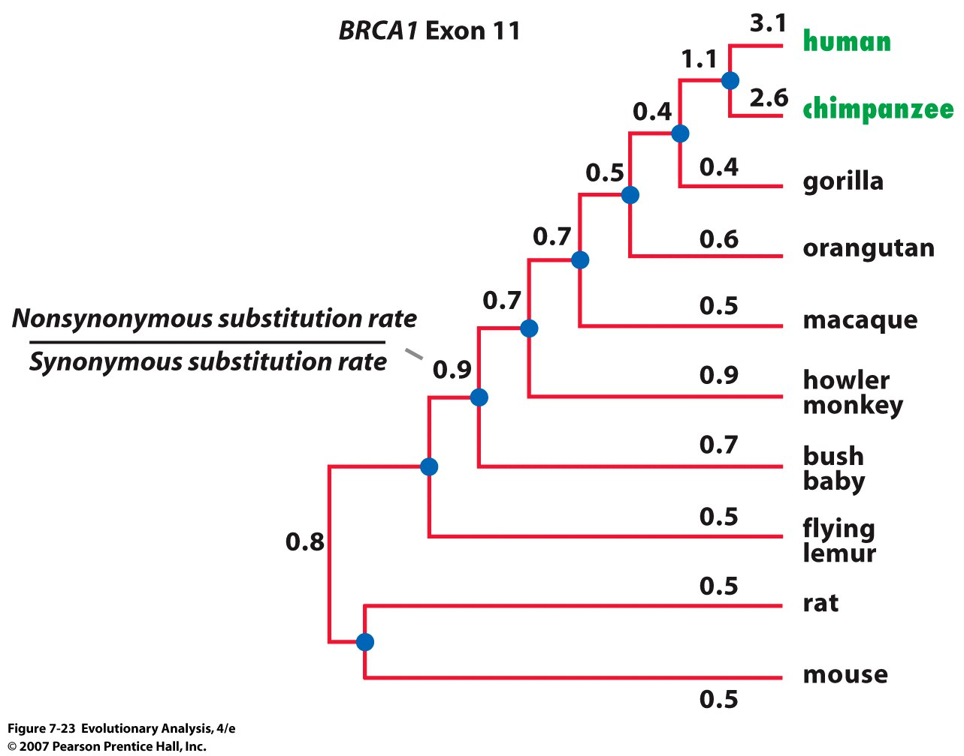
Notes:
Figure 7.23 Positive selection on the BRCA1 gene in humans and chimpanzees
On most branches of this phylogeny, the ratio of replacement to silent substitution rates is less than one, consistent with neutral evolution. On the branches leading to humans and chimps, however, the ratio is significantly greater than one, consistent with positive selection. From Huttley et al. (2000).

Slide 38
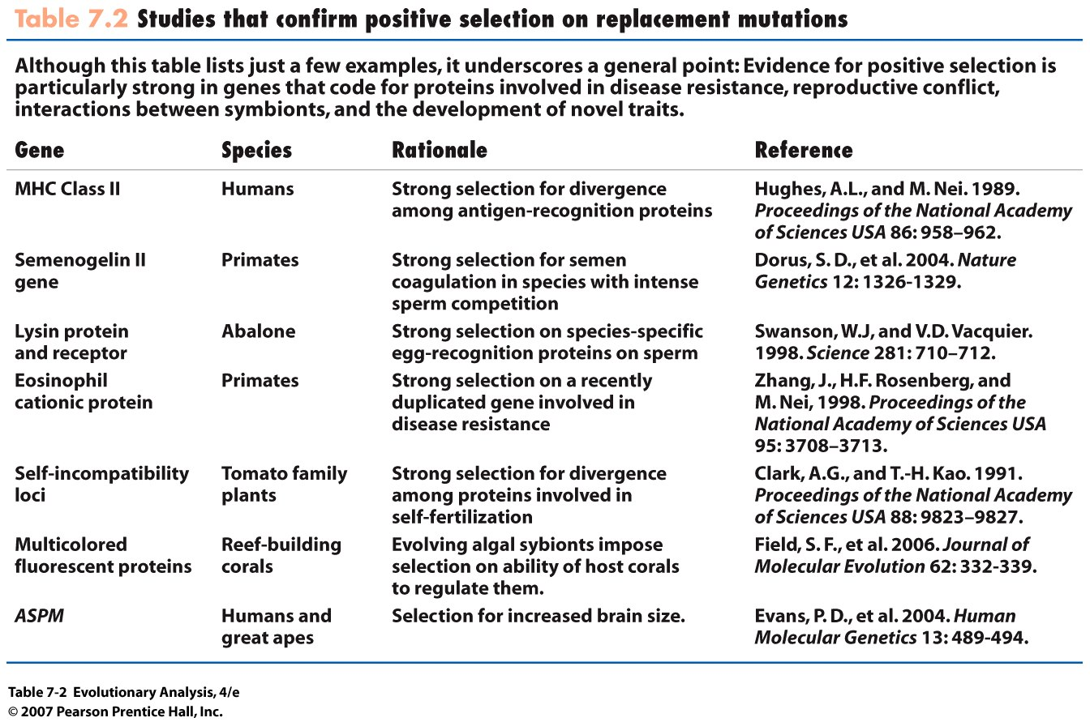
Notes:
Table 7.2 Studies that confirm positive selection on replacement mutations

Slide 39
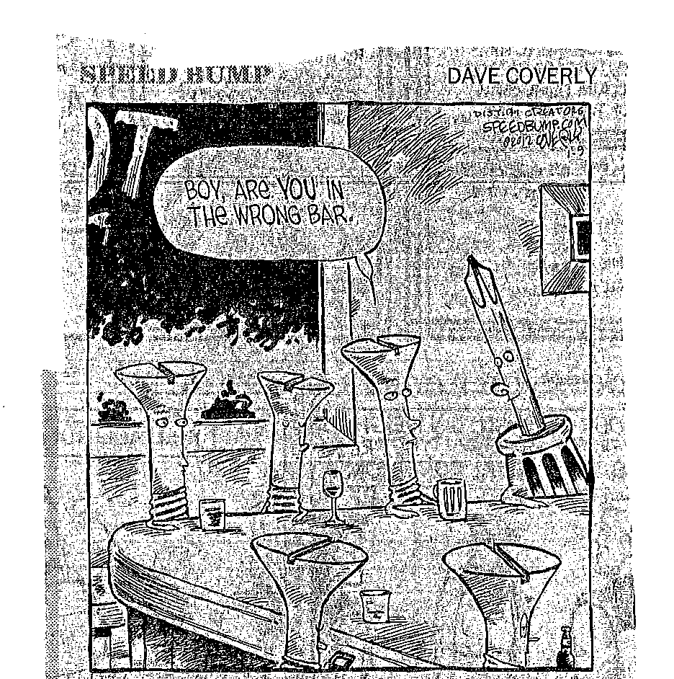
Notes:
Phillips, slotted, Robertson, Hex….etc.

Slide 40
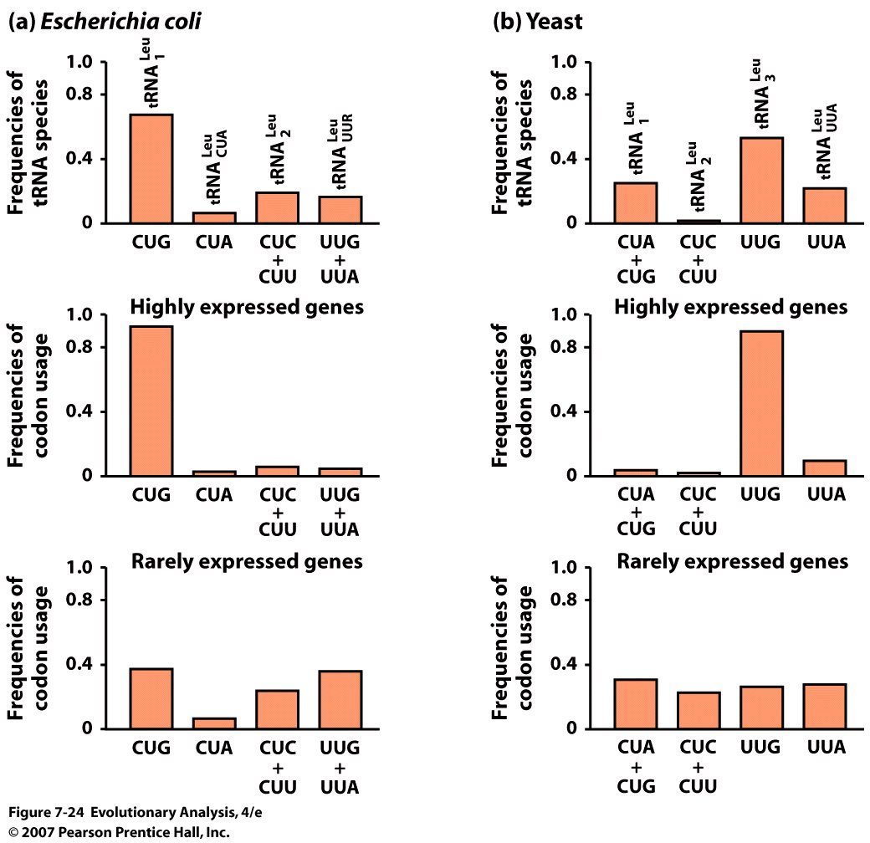
Codon bias correlates with the relative frequencies of tRNA species
Notes:
Figure 7.24 Codon bias correlates with the relative frequencies of tRNA species for Leucine, (6 codons for leucine: highly degenerate)
The bar chart in the top row of both (a) and (b) shows the frequencies of four different tRNA species that carry leucine in E. coli (a) and the yeast Saccharomyces cerevisiae (b). The bar charts in the middle and bottom rows report the frequency of the mRNA codons corresponding to each of these tRNA species in the same organisms. The mRNA codons were measured in two different classes of genes: those that are highly transcribed (middle) and those that are rarely transcribed (bottom). The data show that codon usage correlates strongly with tRNA availability in highly expressed genes, but not at all in rarely expressed genes. From Li and Graur (1991).

Slide 42
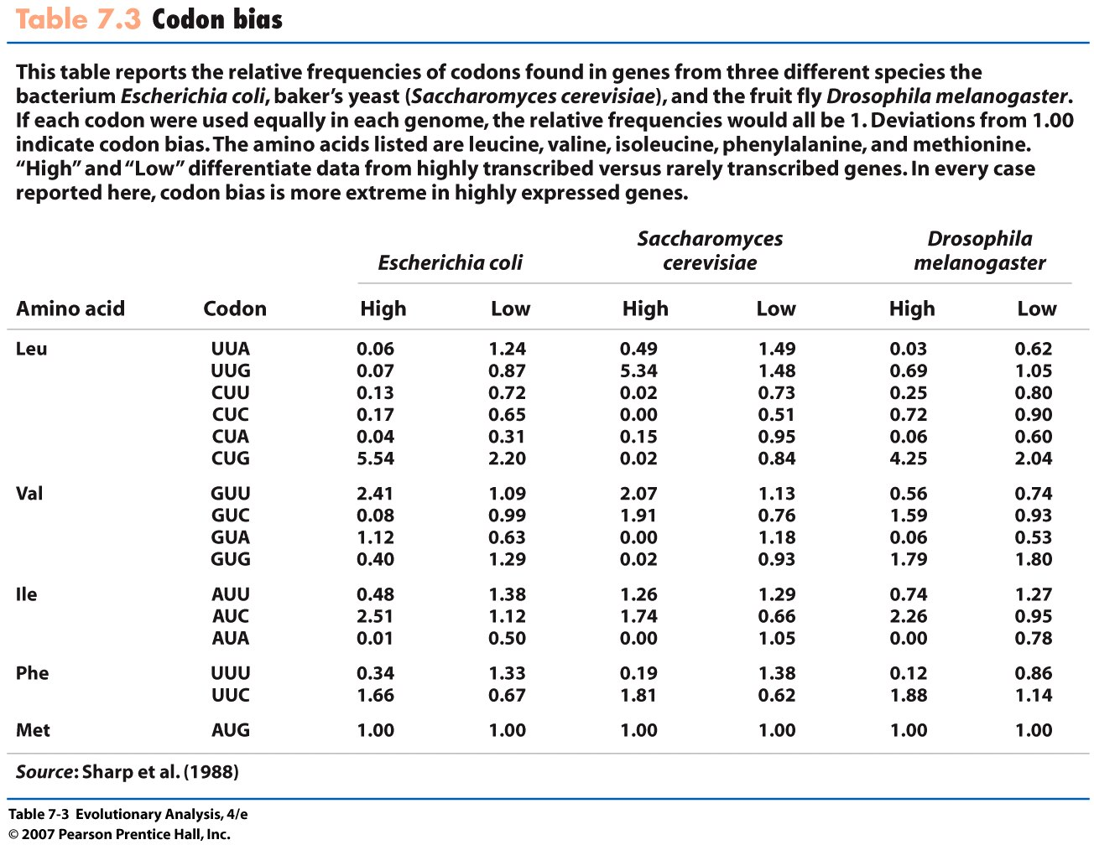
Notes:
Table 7.3 Codon bias

Slide 43
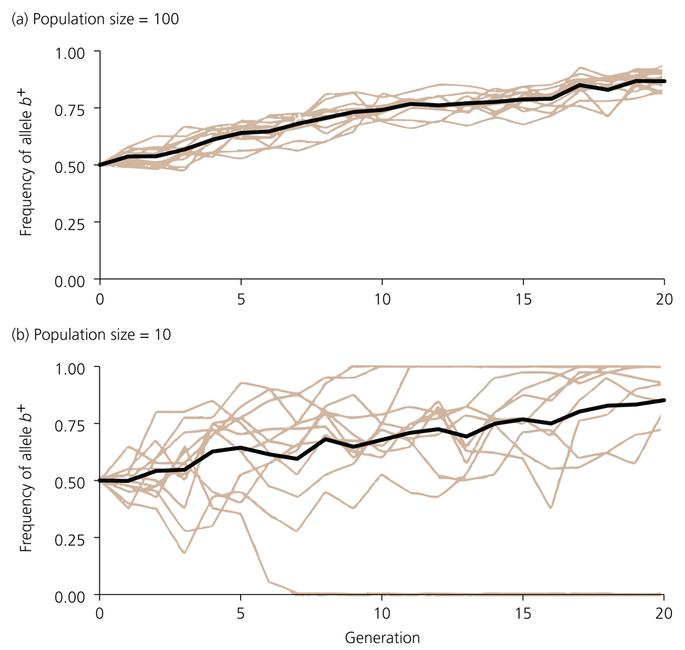
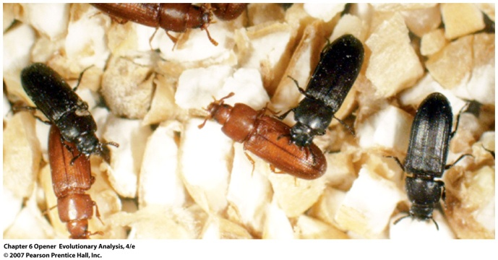
IV. Dynamic Interplay between Drift
and Selection

Slide 44
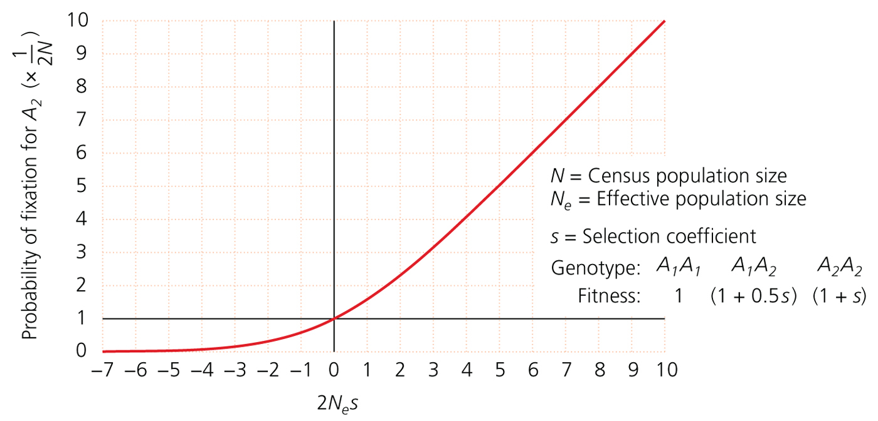
Selection is only effective if its strong or acting in a large population
Deleterious Neutral Beneficial
Notes:
note space for fixation of deleterious mutations

Slide 45
Selection of D. melanogaster for resistance to
ethanol fumes in Large vs. Small populations
Weber, 1992
L = Large
S = Small
Resistance (minutes)
Generation
Consider response to global climate change!

Slide 46
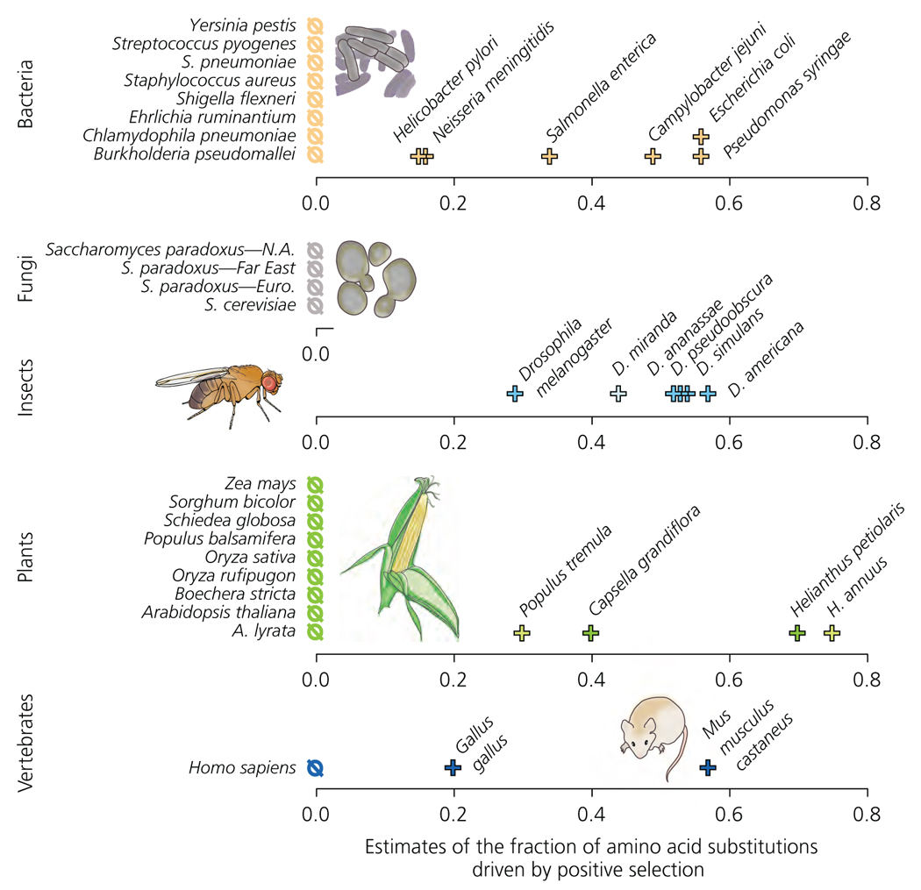
17 – 20 Percent Amino Acid Substitutions Due to Positive Selection*** (adapted from Fay, 2011 by Herron and Freeman 2013)
(p_{N}/p_{S})
a
= 1 -
(d_{N}/d_{S})
*** Mechanism Unknown

Slide 47
V. Inbreeding
Drift can lead to inbreeding
Drift and inbreeding can have the same
consequences

Slide 48
Leviticus
Chapter 18
1 And HaShem spoke unto Moses, saying:
2 Speak unto the children of Israel, and say unto them: I am HaShem your G-d.
3 After the doings of the land of Egypt, wherein ye dwelt, shall ye not do;
and after the doings of the land of Canaan, whither I bring you, shall ye not do;
neither shall ye walk in their statutes.
4 Mine ordinances shall ye do, and My statutes shall ye keep, to walk therein: I am HaShem your G-d.
5 Ye shall therefore keep My statutes, and Mine ordinances, which if a man do,
he shall live by them: I am HaShem.
6 None of you shall approach to any that is near of kin to him, to uncover their nakedness. I am HaShem.
7 The nakedness of thy father, and the nakedness of thy mother, shalt thou not uncover:
she is thy mother; thou shalt not uncover her nakedness. = Parent-Offspring, MUTATION (1/4)
8 The nakedness of thy father's wife shalt thou not uncover: it is thy father's nakedness. FAMILY DYNAMICS
9 The nakedness of thy sister, the daughter of thy father, or the daughter of thy mother,
whether born at home, or born abroad, even their nakedness thou shalt not uncover. = Full/half sib
MUTATION (1/4, 1/8)
10 The nakedness of thy son's daughter, or of thy daughter's daughter, even their nakedness
thou shalt not uncover; for theirs is thine own nakedness. = Grandparent-Grandchild, MUTATION (1/8)
11 The nakedness of thy father's wife's daughter, begotten of thy father, she is thy sister,
thou shalt not uncover her nakedness. = half sib, MUTATION (1/8)
12 Thou shalt not uncover the nakedness of thy father's sister: she is thy father's near kinswoman. = Aunt-nephew,
MUTATION (1/8)
13 Thou shalt not uncover the nakedness of thy mother's sister;
for she is thy mother's near kinswoman. = Aunt-Nephew MUTATION (1/8)
14 Thou shalt not uncover the nakedness of thy fathers brother (niece-uncle) MUTATION (1/8),
thou shalt not approach to his wife she is thine aunt (nephew-unrelated aunt).
15 Thou shalt not uncover the nakedness of thy daughter-in-law: she is thy son' wife;
thou shalt not uncover her nakedness. FAMILY DYNAMICS
16 Thou shalt not uncover the nakedness of thy brother's wife: it is thy brother's nakedness. FAMILY DYNAMICS
Notes:
Torah is a guide to moral living and the sustenance of the Jewish community, My interest in evoluition of sexual systems or how orgainsms mate with one another

Slide 49
Torah: Prohibited Matings And Allowable Matings
Prohibited:
7: Parent-Offspring (Genetic: probability of 2 copies of same mutation = 1/4)
8: Stepmother-Offspring
9: Full-sib (both parents in common) (Genetic: 1/4)
and half-sib (one parent in common) (Genetic: 1/8)
10: Grandfather-Granddaughter (Genetic: 1/8)
11: Half-sib (through father) (Genetic: 1/8)
12: Aunt (father’s side)-Nephew (Genetic: 1/8)
13: Aunt (mother’s side)-Nephew (Genetic: 1/8)
14: Uncle (father’s side)-Niece (Genetic: 1/8), Nephew-Aunt (unrelated)
15: Father-Daughter-in-law
16: Brother-Sister-in-law
Allowable: Grandmother-Grandson (1/8), Mother-Son-in-law,
Uncle (mother’s side)-Niece (1/8)
First Cousin = 1/16
Notes:
Genetic explanation base on probability of getting two copies of a muations., Retain dowery within family 2-4, and talk about allowable matings

Slide 50
Modern Views of Inbreeding (mating among relatives)

Slide 51
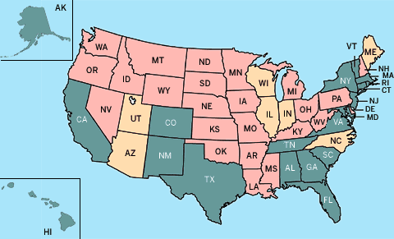
Almost universal prohibition against nuclear family matings
Most cultures prohibit matings closer than first cousins
First cousin marriage illegal
First cousin marriage legal
With genetic counseling
First cousin marriage legal
About 50% of the world’s population avoids inbreeding

Slide 52
Biological mechanisms to avoid mating with relatives
are consistent with law of Torah
Behavioral Avoidance of inbreeding (Humans)
Kibbutz study: 0/2769 marriages within same peer group
0 heterosexual activity within same peer group
T-shirt study: Swiss females prefer men of different genotype at MHC
locus

Slide 53
Incest in Germany
“This law is out of date and it
breaches the couple's civil rights”
Lawyer Endrik Wilhelm
Notes:
Prohibit incest but not homosexuality

Slide 54
Consequences of mating with father, brother or son:
A sample of 161 Czech woman
45
40
35
Incest= inbred progeny
30
Percent occurrence
25
NON-inbred progeny
20
15
10
5
0
Inbred Non-inbred Inbred Non-inbred
Stillborn Mental/Physical Deformities
First cousins:
2-4 % higher risk of birth defects (= parents older than 41)
Notes:
Pku, fhese represent inbreeding of 4 x higher than cousin matings

Slide 55
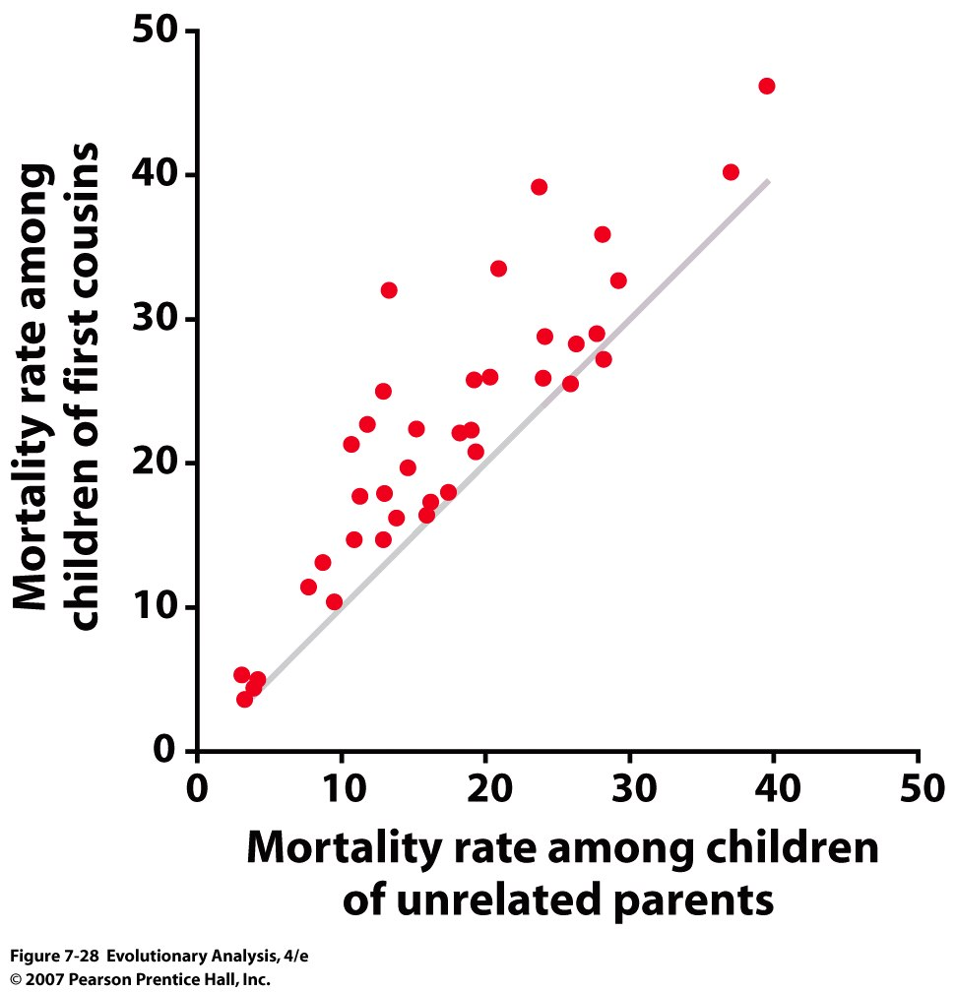
Notes:
Figure 7.28 Inbreeding depression in humans
Each dot on this graph represents childhood mortality rates for a human population. The horizontal axis represents mortality rates for children of unrelated parents; the vertical axis represents mortality rates for children of first cousins. The gray line shows where the points would fall if mortality rates for the two kinds of children were equal. Although childhood mortality rates vary widely among populations, the mortality rate for children of cousins is almost always higher than the rate for children of unrelated parents—usually by about four percentage points. Plotted from data in Bittles and Neel (1994).

Slide 56
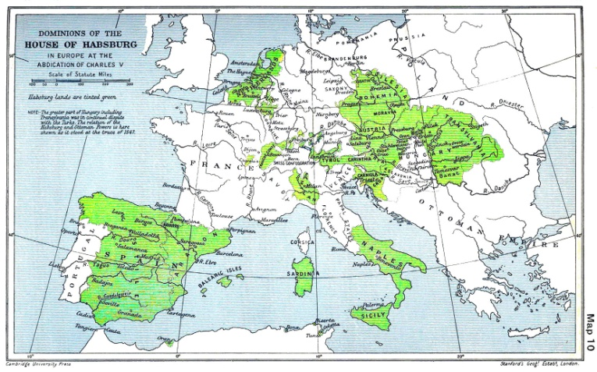
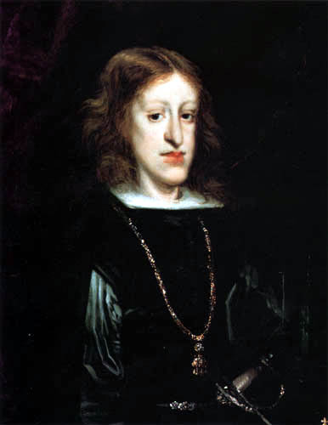
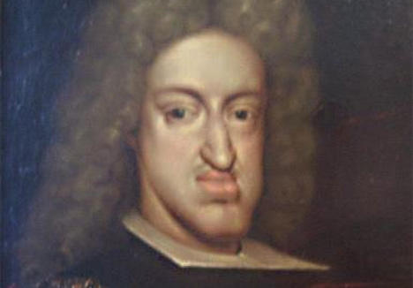
Inbreeding, Inbreeding Depression and the end of the
Hapsburg line: Charles II
http://www.ncbi.nlm.nih.gov/pmc/articles/PMC2664480/pdf/pone.0005174.pdf?tool=pmcentrez

Slide 57
Some Inbreeding Unavoidable
Poor roads led to short “dating distances”
Most matings between humans likely between second cousins or closer

Slide 58
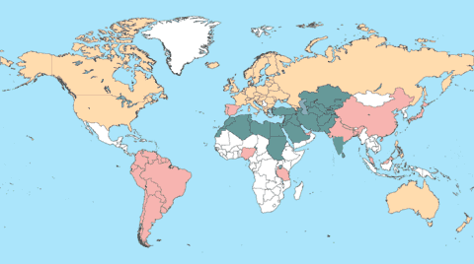
Some human societies promote inbreeding
(probably for retention of resources or tribal alliances)
20-50% of population
2nd cousin or closer
1-10% of population
2nd cousin or closer
Mating within nuclear family is universally prohibited
BUT
Roughly 5% of woman experience incest (likely rape)
Notes:
Even though inbreeding bad…
Global Inbreeding Researchers who study inbreeding track consanguineous marriages—those between second cousins or closer. In green countries, at least 20 percent and, in some cases, more than 50 percent of marriages fall into this category. Pink countries report 1 to 10 percent consanguinity; peach-colored countries, less than 1 percent. Data is unavailable for white countries. Map by Matt Zang Map reproduced with the permission of A.H. Bittles.

Slide 59
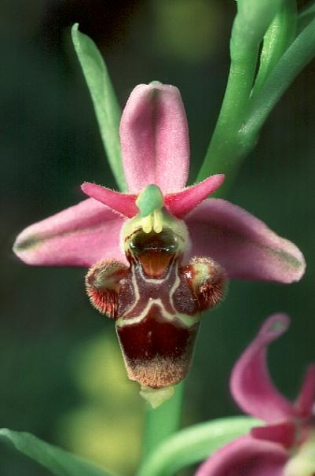
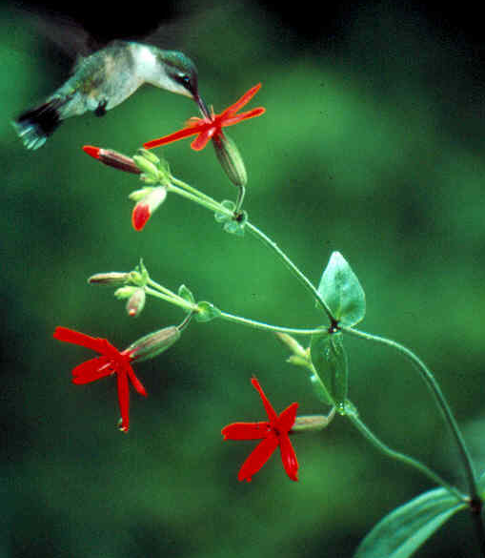
Many organisms avoid inbreeding (most animals & plants)
Animals: No incest within Chimps and Gorillas
Plants:
Flowers are reproductive organs
Plants have many strategies to get their sperm to ANOTHER plant
Silene virginica
Ophrys scolopex
Notes:
Even though they have both sexual parts capapble of slefing.

Slide 60
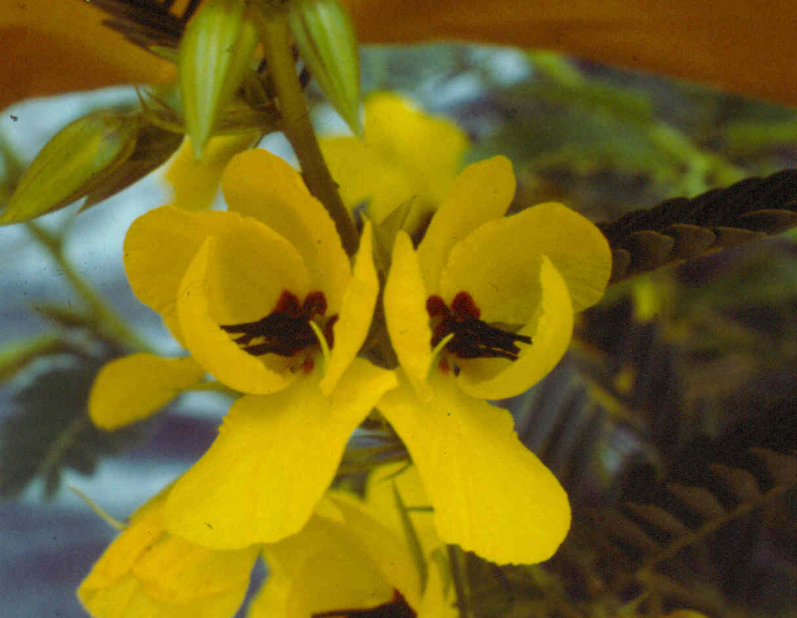
Complex structure of the flower to avoid self-fertilization
Enantiostyly in Chamaecrista fasciculata
Male part
Female part

Slide 61
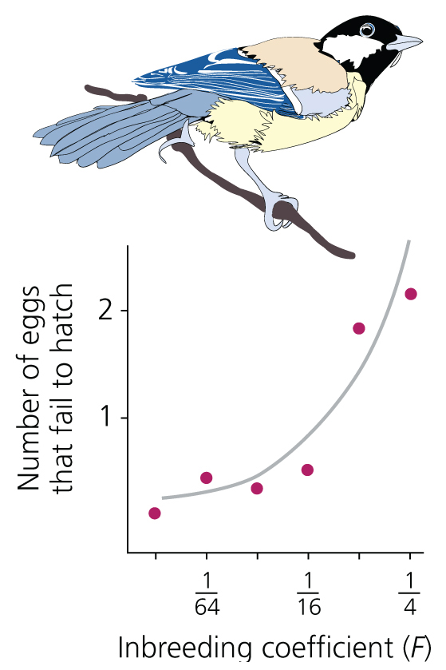
Inbreeding increases egg failure in great tits
Notes:
Go through inbreeding coefficient of offspring

Slide 62
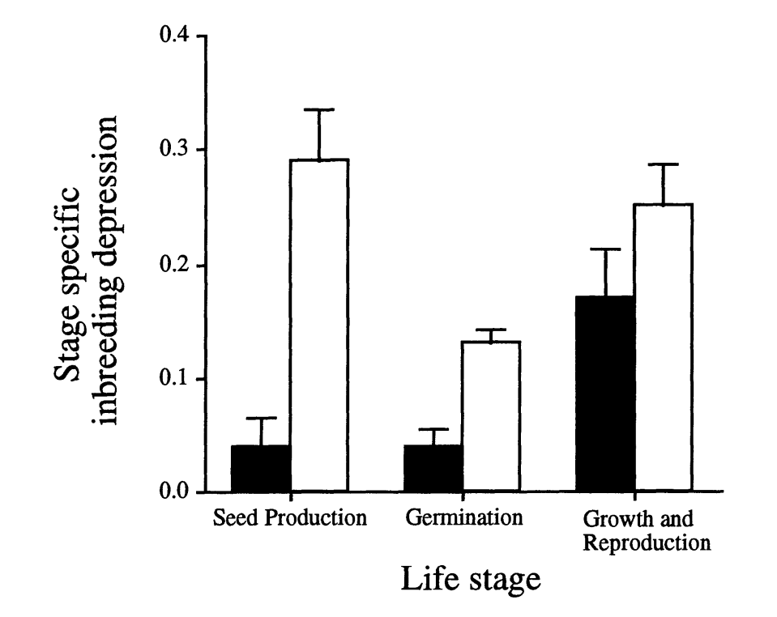
Consequences of mating among relatives (animals):
About 35% reduction of vigor in captive mammal
populations following sib mating
Consequences of self-mating (plants)
Selfing species
Outcrossing species
Inbreeding depression =
1- fitness(inbred/outbred)
Notes:
Onne half vs ¼, all genes in common

Slide 63
Sometimes Plants (like humans) promote inbreeding (self-fertilization)
Two different but closely related species:
Attractive outcrosser
C. fasciculata
UNattractive selfer
C. nictitans
Curled stigmas
Hibiscus laevis
Female
parts
Male parts
Self at the end of the life of a flower = last chance strategy to make seed

Slide 64
Why does mating among relatives lead to “poor” progeny?
Most bad mutations are recessive
Inbreeding increases chance of inheriting two copies of the same bad mutation
F = degree of inbreeding
= probability that the two alleles in an individual are Identical By Descent
Notes:
Also extra inbreeding due to small population size and also due to past inbreeding, diagram unrelated matings that are prhibited. What are the consequences in terms of penaltiy of law.

Slide 65
Inbreeding alters genotype frequencies
Notes:
Figure 7.25 Inbreeding alters genotype frequencies
(a) This figure follows the genotype frequencies in an imaginary population of 1,000 snails from one generation's adults (lower left) to the next generation's zygotes (upper right). The frequencies of both allele A₁ and A₁ are 0.5. The colored bars show the number of individuals with each genotype. Every individual reproduces by selfing. Homozygotes produce homozygous offspring and heterozygotes produce both heterozygous and homozygous offspring, so the frequency of homozygotes goes up, and the frequency of heterozygotes goes down. (b) These bar charts show what will happen to the genotype frequencies if this population continues to self for two more generations. The orange portions of the bars show the decrease in heterozygosity and the increase in homozygosity due to inbreeding.

Slide 66
Eventually the frequencies of homozygotes are p and q
Heterozygosity decreases by Fpq (F=1/2 for selfing)
Homozygosity increases by Fpq (F=1/2 for selfing)
Notes:
Table 7.4 Changes in genotype frequencies with successive generations of selfing 1-Fpq – decrease in heterozygosity, 1 + Fpq = increase in homozygosity:
(1-F)p2 [outbred]+ Fp[inbred]
P2 –Fp2 +Fp = p2 + F(p-p2) = p2 + Fp(1-p) = p2 + Fpq

Slide 67
Calculating F from a pedigree: Half Sib mating
Notes:
Figure 7.27 Calculating F from a pedigree
In parts (a) and (b), squares represent males; circles represent females; arrows represent the movement of alleles from parents to offspring via gametes.The red triangles and blue diamonds represent alleles at a particular locus.

Slide 68
Probability of offspring being homozygous for one of the 4 alleles
A1A2 A3A4
A1A2 A3A4
Brother – Sister:
4/16=1/4
First Cousins:
4/64=1/16
Notes:
Probability of inheriting A1 for the brother is ½ x ½ and through the sister is ½ x ½ = ¼ x ¼ =1/16

Slide 69
Why is inbreeding Bad??
Increases chance of expression of lethal recessive allele
Example: Recessive lethal alleles in mutation selection balance: 1 x 10⁻³
About 4000 human genetic disorders, assume ¼ are lethal = 1000
Thus for 1000 loci that can have lethal alleles:
The probability of being homozygous for the lethal recessive allele = q²
Thus probability of NOT being homozygous for a recessive lethal allele:
= (1- (1 x 10⁻³)²)¹⁰⁰⁰ = 0.999 or 0.1% of all zygotes in random
mating population homozyogous
for a lethal
But with Brother-Sister mating : homozygous recessive progeny can be created by random union and non random union of gametes:
q²(1-F) + qF
= [1- ((1 x 10⁻³)² (1-F) + (1 x 10⁻³)F)]¹⁰⁰⁰ = [1- ((1 x 10⁻³)²(3/4)+q(1/4))]¹⁰⁰⁰
= 0.79 or 21% zygotes homozygous for lethal
Thus inbreeding depression is 1- 0.79= 0.21
Notes:
There are two ways of being homozygous for the recessive allele:
1 by the union of sperm and egg from random mating: q2(1-F)
2nd by the union of sperm and egg between relatives: qF
Or: q2(1-F) + qF
which also equals pq(1-F),
because the frequency of the homozygote recessive is increased by the same amount that heterozygotes are decreased through inbreeding 2pgF, but of course only ½ of the decrease of the heterozygote goes to the increase of the homozygote recessive
There are two ways of not being homozygous:
Probability of not being homozygous through random mating (1-q²)
Probability of not being homozygous through inbreeding is the reduction of heterozygotes that go towards making the homozygote recessive: Fpq
Also go back a slide

Slide 70
V. Consequences of Drift and Inbreeding for Population Viability
http://www.youtube.com/watch?v=s2_wdMmEupQ
Notes:
Figure 7.1 A greater prairie chicken
This male has inflated his air sacs and fanned his feathers as part of his courtship display.

Slide 71
Notes:
Figure 7.2 Habitat destruction and the shrinking range of Illinois greater prairie chickens
Map (a) shows the extent of prairie in Illinois before the introduction of the steel plow. Maps (b), (c), and (d) show the distribution of the greater prairie chickens in 1940, 1962, and 1994. From Westemeier et al. (1998).

Slide 72
http://www.youtube.com/watch?v=s2_wdMmEupQ
Notes:
Figure 7.3 A greater prairie chicken population in danger of extinction
This graph plots the number of male prairie chickens displaying each year on booming grounds in Jasper County, Illinois, from 1963 to 1997. Redrawn with permission from Westemeier et al. (1998).

Slide 73
Notes:
Figure 7.31 Declining hatching success in a greater prairie chicken population
This graph plots, for greater prairie chickens in Jasper County, Illinois, the fraction of eggs hatching each year from 1963 to 1997. The small number below each data point indicates the number of nests followed; the whiskers indicate +/- 1 standard error (a statistical measure of uncertainty in the estimated hatching rate). The decline in hatching success from the mid-1960s to the early 1990s appears to reflect inbreeding depression. Redrawn with permission from Westemeier et al. (1998).

Slide 74
Notes:
Table 7.6 Number of alleles per locus found in each of the current populations of Illinois, Kansas, Minnesota, and Nebraska and estimated for the Illinois prebottleneck population

Slide 75
Population size and genetic diversity
Notes:
Figure 7.19 Population size and genetic diversity
Each data point on these scatterplots represents a population of flowering plants. Polymorphism, plotted on the vertical axis of the graphs at left, is the proportion of allozyme loci at which the frequency of the most common allele in the population is less than 0.99. In other words, polymorphism is the fraction of alleles that are substantially polymorphic. Allelic richness, plotted on the vertical axis of the graphs at right, is the average number of alleles per locus. The statistic r is a measure of association, called the Pearson correlation coefficient, which varies from 0 (no association between variables) to 1 (perfect correlation). P specifies the probability that the correlation coefficient is significantly different from zero. Salvia pratensis, Scabiosa columbaria, and Gentiana pneumonanthe are all flowering herbs; Eucalyptus albens is a tree. [The blue dots in (c) right represent small populations isolated by less than 250 m.] Reprinted from Young et al. (1996).

Slide 77
Low High
Extinction Rate
Low High
Heterozygosity

Slide 78
Loss of Genetic Variation
Lakeside Daisy (hymenoxys acaulis var. glabra)
M. Demauro, 1994
Last remaining population in Illinois
Lakeside Daisey is Self Incompatible

Slide 79
Number of Mating Groups

Slide 80
Recovery of the Florida Panther
floridapanther.com

Slide 82
Black-footed Rock Wallaby Recovery Program Mark Eldridge, Australian Museum
“To be too similar is bad, to be different is good”
“All are recently related”
Translated from Pitjinjara
Notes:
aborigines to enable small isolated rock wallaby populations to be outcrossed would make a fine Box in the Genetic Rescue chapter in GMFAPP.
Mark described the meeting with people who mainly spoke the Pitjinjara language and many had little or no English. I was taken with two of their quotes in particular:
'Too same bad, need more different'
'Long time ago one big

Slide 83
VI. Conclusions
Small populations will lead to increase in homozygosity,
decrease in heterozygosity, and increased genetic differences
between populations
Variation in sex ratio, population size, will lead to inbreeding
Drift is an important force in evolution
There are many traits that serve to avoid inbreeding and
inbreeding depression
Conservation implications

